Slide 1
Notes:
Welcome to Ohio Wesleyan’s Open Enrollment! We are McGohan Brabender, OWU’s benefits broker and consultant. Open enrollment is the one time a year you may change your benefits, these changes are effective on July 1st, 2019 and then you are locked in for the year. During this time you may add dependents, drop dependents, or change any benefits, unless you experience a qualifying event you may not change your elections until next year’s open enrollment. Qualifying events are your big life events like getting married, divorced, having a baby, adopting, or a spouse’s open enrollment. We are excited for the changes we are introducing this year and truly believe this will make a better health care experience for our OWU employees.

Slide 2
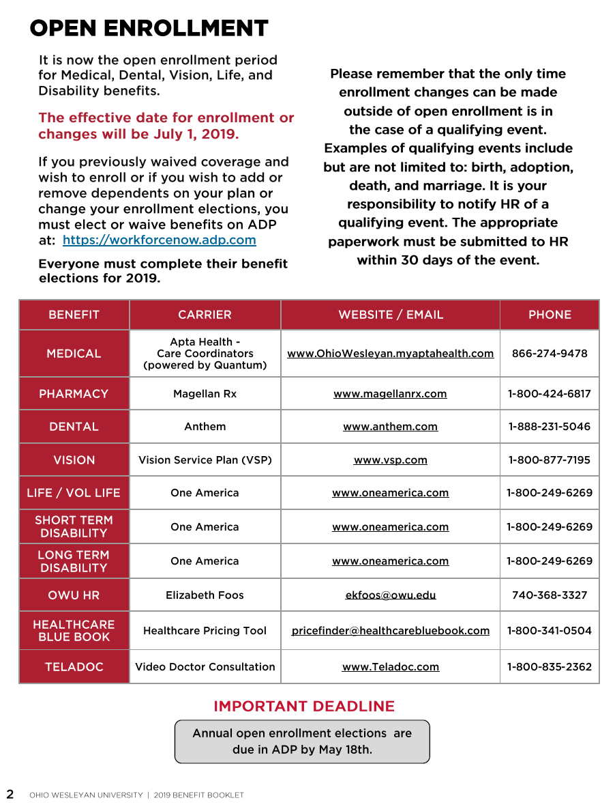
Notes:
All your elections must be made on the ADP work force now site by May 18th. On this slide you will see that our medical plans will now be through Aetna for administration and network with Apta Health as our care coordinators. We will be using Magellan Rx for our pharmacy needs. We will be keeping the same two medical plans, the PPO plan and the High Deductible Health Plan. If you would like to hear more information please be sure to listen to the presentation dedicated to Apta and their care coordination model on the HR website. We are excited to be partnering with Apta as they will be providing OWU employees better care and better rates.
All other lines of coverage will be staying the same. Please reach out to HR or our Benefits Broker and Consultants McGohan Brabender if you have any other questions. Again, all enrollments need to be entered in ADP by May 18th.

Slide 3
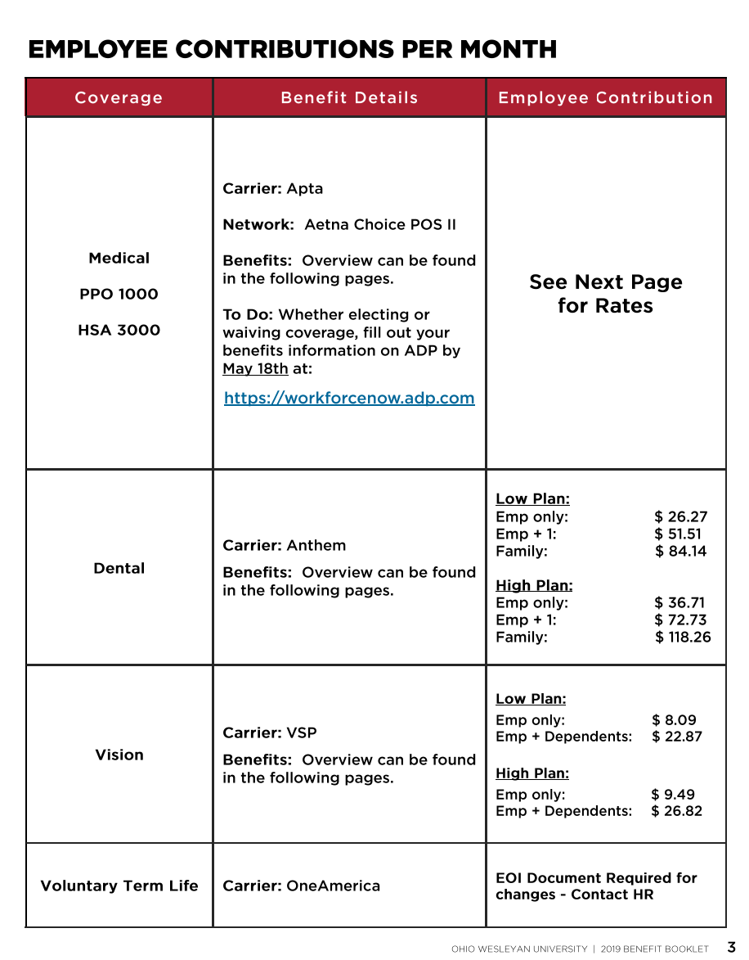
Notes:
The next couple pages will show you the contributions per month for all lines of coverage. If you would like to elect or change your voluntary life benefits, please reach out to HR.

Slide 4
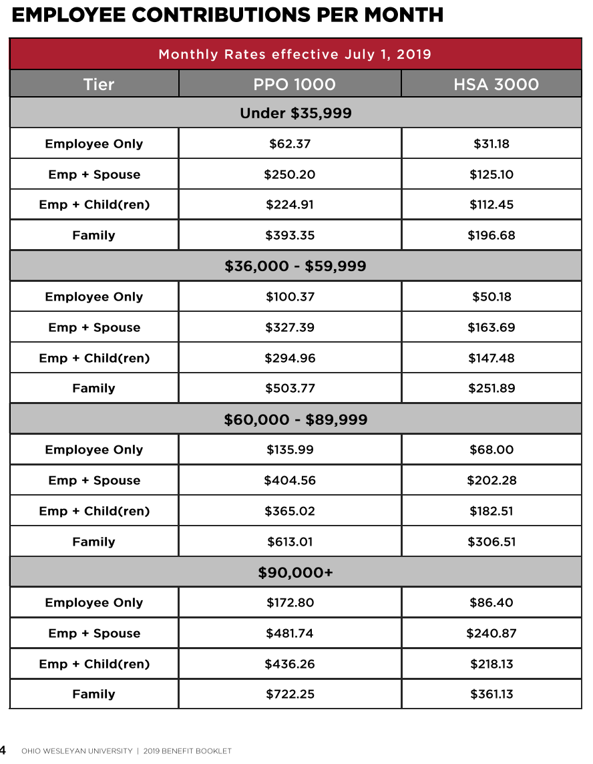
Notes:
Here are your monthly contributions based on your salary tier for both plans.

Slide 5
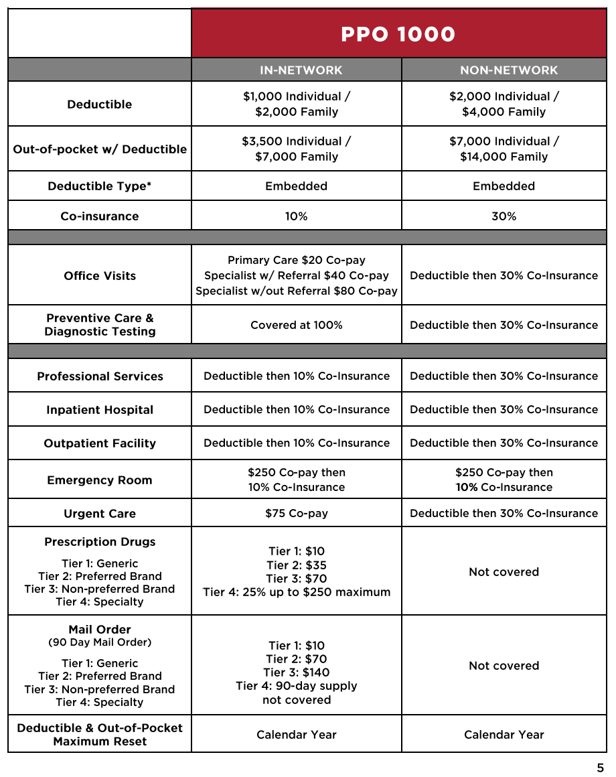
Notes:
For both medical plans you will be seeing minimal changes in the plan design – the network change is what we would like to bring your attention to. We will be using Aetna’s network, please take the time to check if your current providers are in-network with Aetna. If you are currently receiving care with an in-network Anthem provider but then find that this provider is out of network with Aetna, please reach out to our McGohan Brabender advocate team to see if your provider will join the Aetna network. If the provider will not join the Aetna network, OWU will reimburse claims at current in-network rates for one year.
Your PPO deductible is $1,000 for an individual and $2,000 for a family. The deductible is embedded which means that if you are on a family plan you are protected as an individual. For example, if I am in a family with my husband and child and I get really sick – I can meet my individual deductible then pay the co-insurance of 10% until I hit the individual out of pocket max. The rest of my family can then meet the family deductible and out of pocket max.
For an office visit, you will have a $20 co-pay. For a specialist visit your co-pay with a referral is $40 while a specialist visit without a referral is an $80 co-pay. This is a change this year. All the medical plans will cover your wellness and preventive visits in full. Note the $250 co-pay for an emergency room visit and the $75 co-pay for an urgent care visit. Both medical plans have four tiers for your prescription drugs; retail covers your 30 day supply while mail order with cover a 90 day supply of your medications.
Please keep in mind that your deductible and out-of-pocket maximum will reset on a calendar year for both plans. That means even though the plans are effective July 1st, your deductibles don’t reset until January.

Slide 6
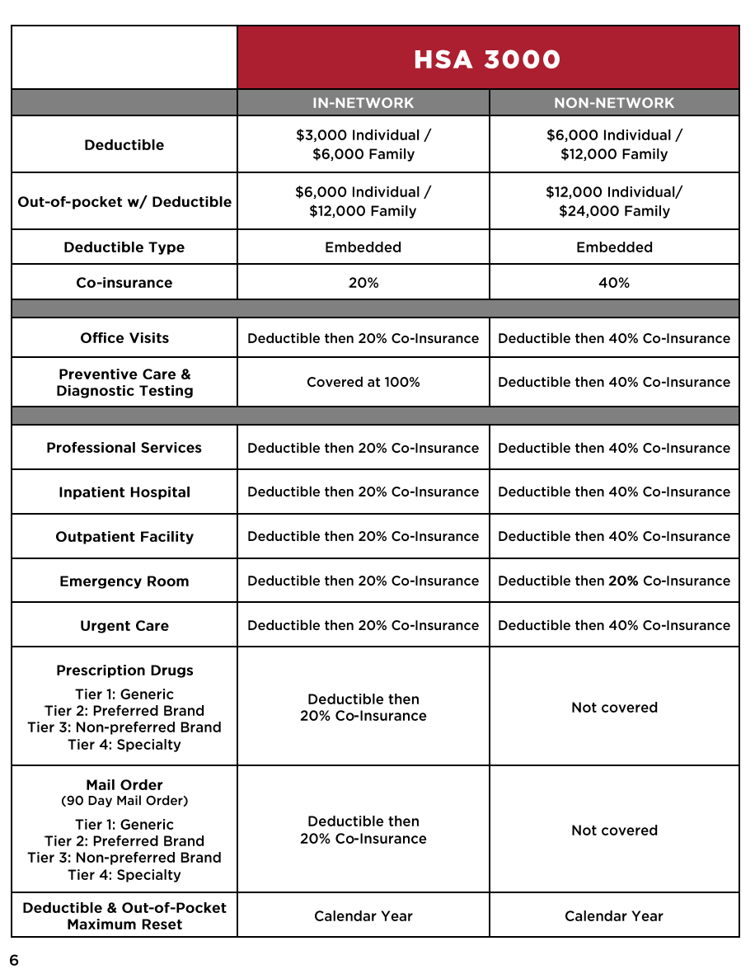
Notes:
The plan design for the HDHP is also staying the same. As an individual you will have a $3,000 deductible and as a family you will have a $6,000 deductible you will need to reach before your co-insurance kicks in. With the high deductible health plan you do not experience any first dollar coverage like your co-pays, you are on the hook for 100% of your medical and pharmacy costs until you reach your deductible. After you hit your deductible, you will experience your 20% co-insurance for specified services or co-pays until you hit your out of pocket max. For an individual your out of pocket max is $6,000 and your family out of pocket max is $12,000 – these are your worst case scenarios for the year, once you hit these limits you are done paying for your medical and prescription services. As a reminder, your preventive care under both plans is covered at 100%, regardless of where you are at in your deductible.
Jumping down to the prescription rows – your medications are divided up into the same 4 tiers. Once you hit your deductible you will have a 20% co-insurance in all your medications. Again, your deductible and out of pocket maximum will not reset until January 1st even though the new benefit plans are effective on July 1st.

Slide 7
Notes:
Your FSA benefit can only be paired with the PPO, however the dependent care FSA is available to employees on either the PPO or HDHP. There is an ACTIVE enrollment for the FSA so please make sure you elect those benefits when you elect for your total benefits package. There is an annual maximum of $2,650 for the FSA and $5,000 annual maximum for the Dependent care FSA. There is a $500 allowable carry over amount if you are re-enrolling into the FSA. The next few slides are dedicated to the FSA card, site, and mobile app.

Slide 11
Notes:
If you are enrolled on OWU’s High Deductible Health Plan – you are eligible for a Health Savings Account (HSA), this savings account may be opened with Pathways Financial Credit Union. You may put money in pre-tax and spend it tax-free on medically qualified expenses to help you with your higher deductible when paying for your medical services or medications. Please note that the contribution limits for 2019 have increased to $3,500 for single coverage and $7,000 for family coverage. If you are over the age of 55 you are allowed to contribute an additional $1,000 every year. Once you hit 65, you are eligible to roll over any funds in your HSA plan into a retirement plan and use it on any expenses. To contribute money into the HSA you may not be enrolled in any other kind of coverage, for example medicare or tricare. Any money that you put into your HSA is YOURS – if you leave OWU the money you have accumulated stays in your HSA and you can continue to contribute into the plan as long as you are enrolled in a HDHP.
OWU’s generous HSA contributions will be staying the same this year - $1,500 annually for employees enrolled in single coverage and $3,000 for employees enrolled in family coverage.
Please see the IRS website for an extensive list of medically qualified expenses you may use your HSA funds on. Remember to keep record of the funds you spend your HSA funds on as there is always a chance you may be audited by the IRS and they may request proof that you spent your funds on medically qualified expenses.

Slide 12
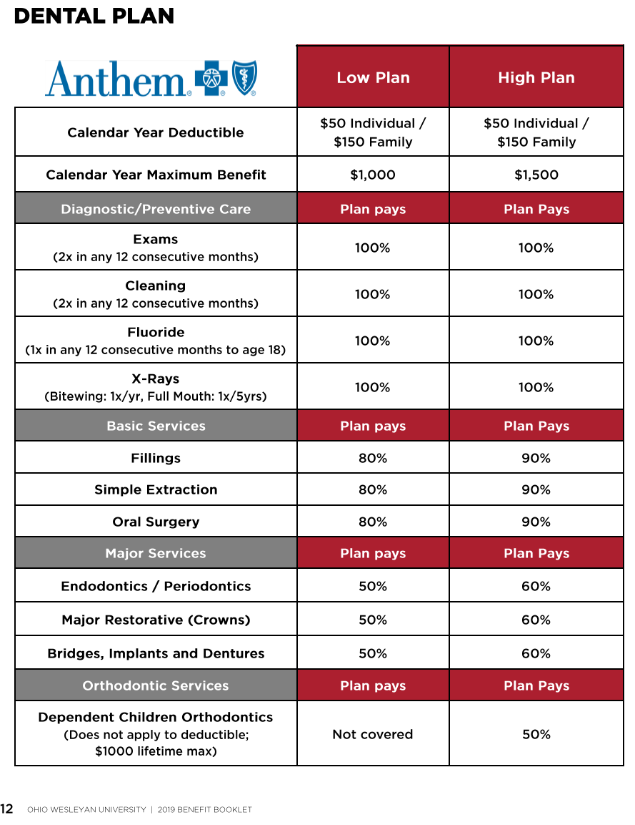
Notes:
The next couple of slides will cover your dental and vision plans – again, these are staying the same. There will be no change to your carriers, plan designs, or rates.

Slide 13
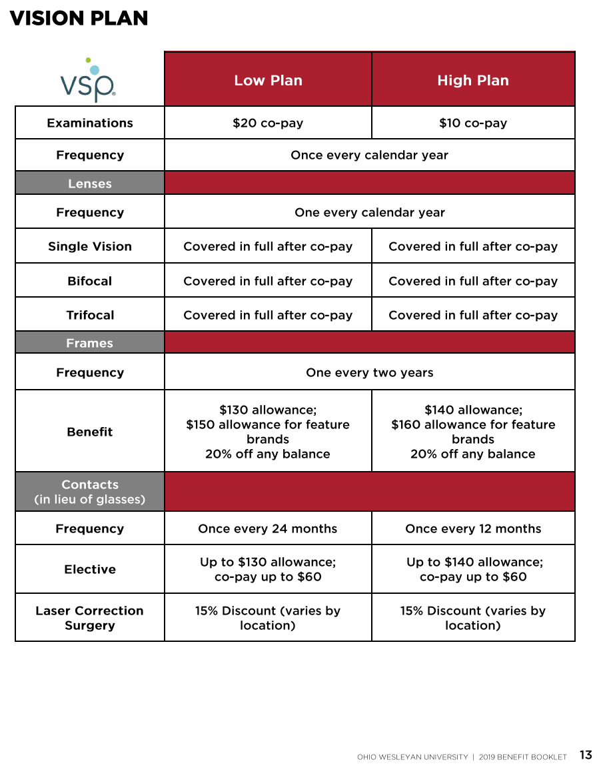

Slide 14
Notes:
We will begin using the services of Apta Health to assist all of our members in accessing health care services. Apta Health provides a coordinated care approach with advocates specifically dedicated to OWU members. These advocates, located just down US 23 in Columbus, make up one dedicated team of healthcare experts focused on your care. This team will proactively assist with your healthcare needs, from providing the most basic service - like helping you obtain a new ID card, to working through the most complex treatment plan; including providing referrals and assisting with pre-certifications and billing issues. By partnering with Apta, we are hoping to simplify the healthcare process for our OWU employees.
For more information on Apta, please refer to the Apta presentation on the HR website.

Slide 15
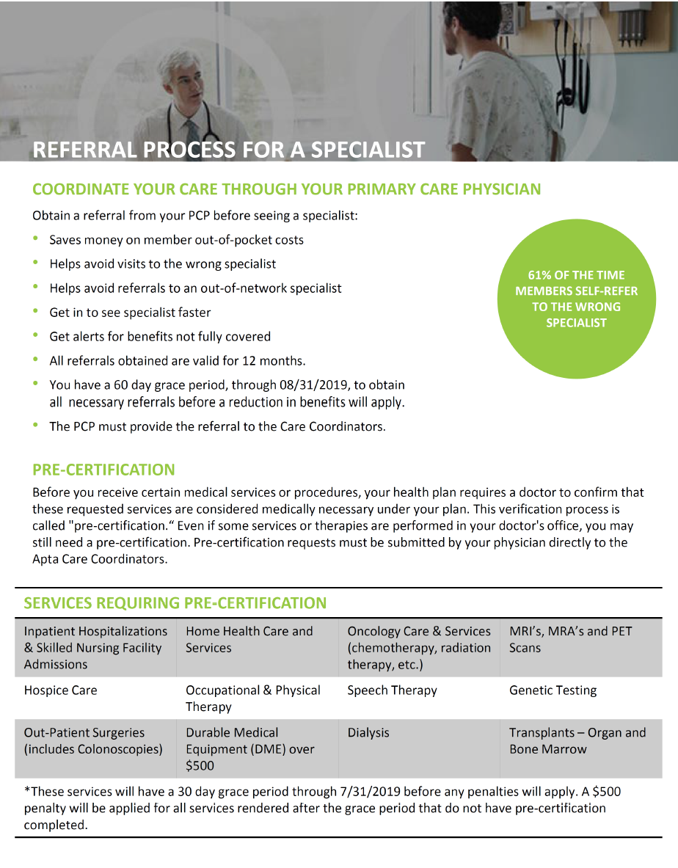

Slide 16
Notes:
Teladoc is a benefit that gives you 24/7/365 access to U.S. board-certified doctors who can resolve any non-emergency medical issues via phone or online video. Instead of waiting in a doctor’s room if you suspect you have bronchitis, pink eye, or the flu you can call a doctor from the comfort of your own home and save money on a sick visit, which averages about $120. The cost of a Teladoc consult is a $0 co-pay if you are on the PPO plan or a $49 charge if you are on the HDHP. The reason for the cost associated with the HDHP is because there can be no kind of first-dollar-coverage with this plan.

Slide 17
Notes:
OWU will keep Healthcare Blue book and its services they provide as an online pricing tool intended to help you with your provider decisions. Health Care blue book allows you to shop for care and find the most affordable and highest quality provider in your area.

Slide 18
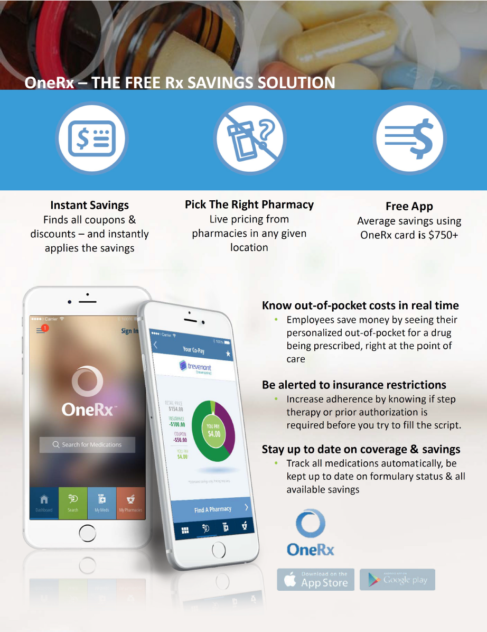
Notes:
Make sure to download the OneRx app, this will assist you in finding coupons and discounts for your medication and the pharmacies that will provide the best prices for your medications.

Slide 19
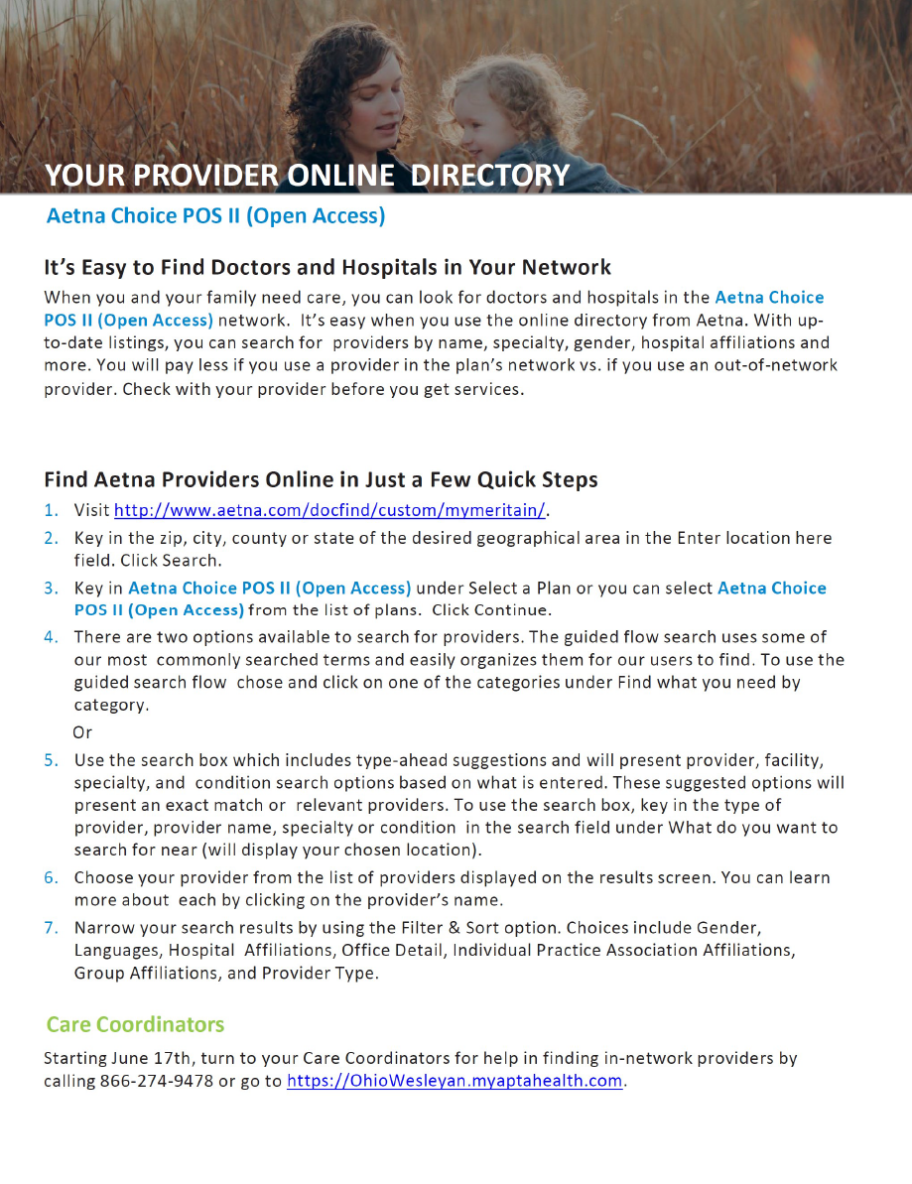
Notes:
Please see the attached flyer for finding in network providers. The Aetna network OWU will be utilizing is the Aetna Choice Open Access network. Follow the instructions to find if your provider is in network. If your provider is not in-network, please be sure to reach out to our MB Advocate team for assistance. Starting June 17th, when you reach out to your Apta Care Coordinators they will be able to assist you with finding in-network providers.

Slide 20
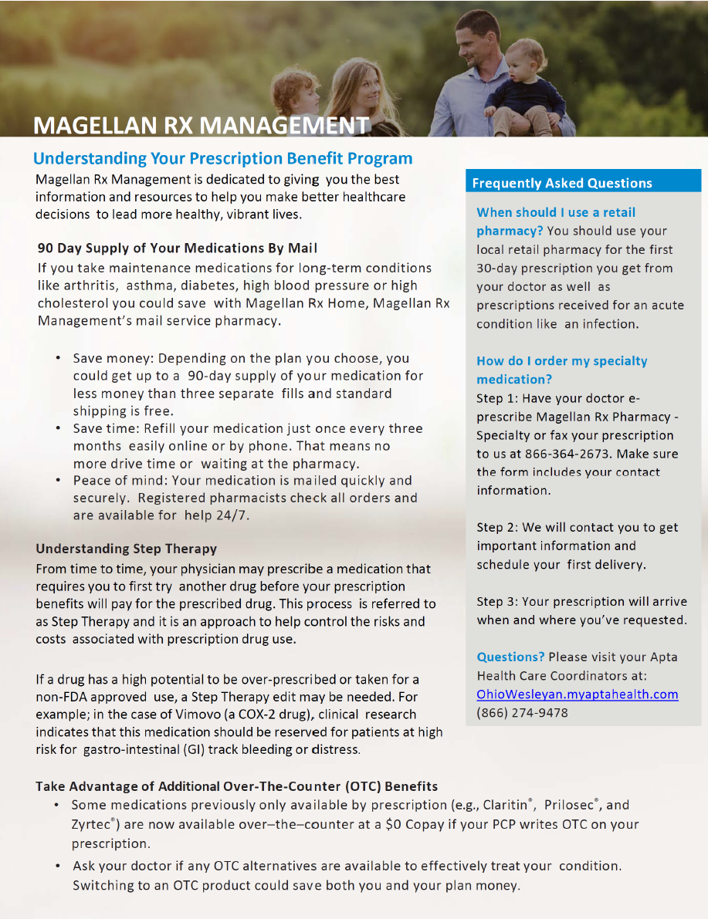
Notes:
Please see the attached information regarding your new pharmacy benefit manager, Magellan rx. This flyer provides helpful information on your 90 day supply medications as well as how to navigate step therapy. While rx management can be confusing, please do not hesitate to reach out to Apta to assist in your health care needs.

Slide 21
Notes:
With Magellan Rx there is a great program dedicated to helping you save on your medication with over the counter alternatives. Some brand name ulcer or allergy drugs are now available over the counter. If those over the counter medicates are available with the same strength as your prescription drugs you are now taking the over the counter medications may provide some savings for you. Your new pharmacy plan with Magellan Rx can cover those select over the counter medications at a low or free co-payment.
Follow the three following steps to take advantage for this program: 1) ask your physician to write a prescription for the specific over the counter medication 2) take the prescription to your local pharmacy and have them fill your out of the counter medication just like any other prescription and receive the low co-pay and finally 3) follow your doctor’s instructions on how to take the medication.

Slide 22
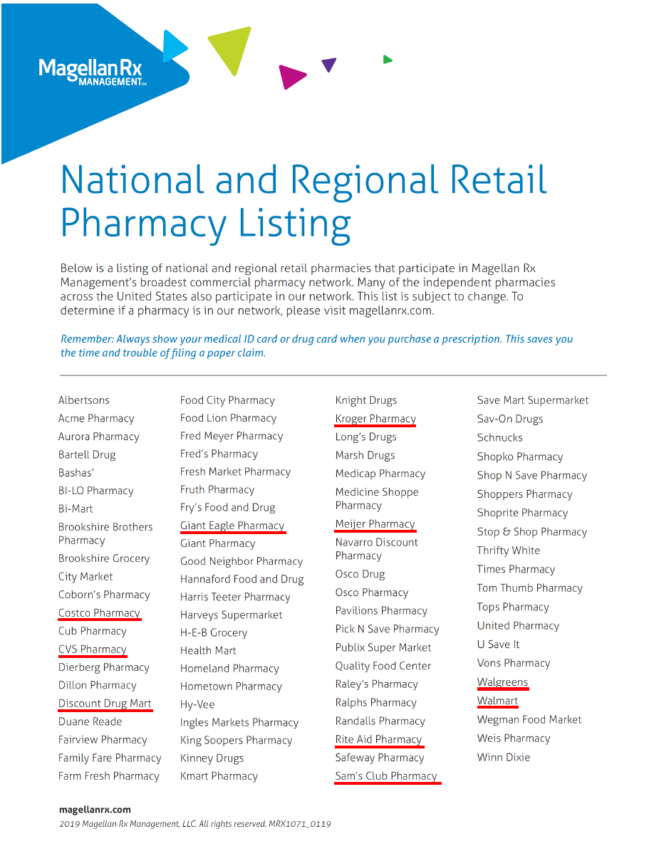
Notes:
Please see this list for in-network national and regional retail pharmacies. Underlined are pharmacies that are available in the Columbus area.

Slide 23
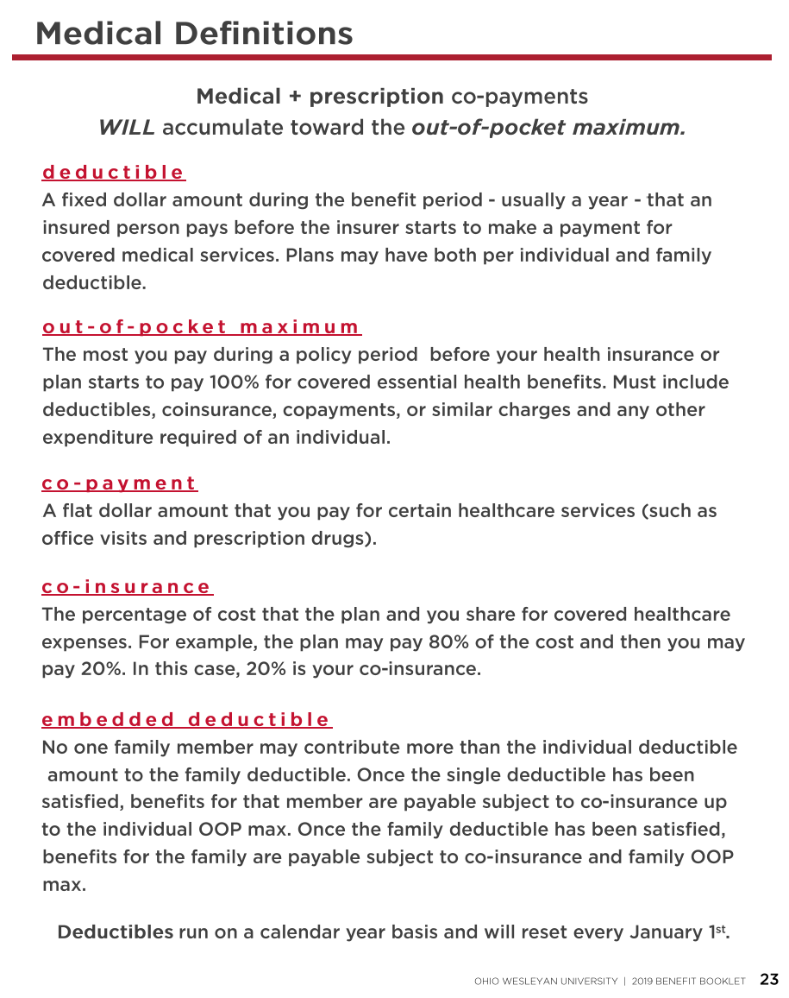

Slide 24
Notes:
If you are nearing or are at Medicare eligible age, we have a sister company called RetireMedIQ that may be able to assist you with your Medicare questions. They are a completely free resource to you – if you reach out they can assess your healthcare needs and financial situation and advise which plan is better for you, Medicare or OWU’s plans. Once you connect to RetireMedIQ you will have one counselor who can walk you through the plans as well as through the enrollment process.

Slide 26
Notes:
Thank you for your time! If you have any lingering questions please direct them to HR or McGohan Brabender. Make sure to complete your enrollments on ADP by May 18th and if you are electing voluntary life for the first time or making any changes, make sure to see HR and fill out an Evidence of Insurability Form.
Have a great day!

