Slide 1

Ohio Wesleyan University
It’s Time for Open Enrollment!
For July 1, 2025 – June 30, 2026

Slide 2




Open Enrollment Meeting Facilitators:
Ohio Wesleyan University’s Benefits Partners
Today’s Agenda
What’s Changing?
Benefits Overview
Cost
To-Do’s
Naomi Koehler
Sr. Account Manager
Hadiya Swift
Sr. Account Relationship Manager
Maddie Zimmer
Sr. Benefit Specialist

Slide 3

What’s the Same?
What’s Changing?
No increase to employee medical rates and same plan design! OWU is absorbing the cost increase for the second year in a row.
Medical Provider: Meritain utilizing the Aetna network with support from the Apta Care Coordinators
Life, Disability, & Supplemental Health Benefits: Guardian & Voya
OWU Employer HDHP/HSA Contributions:
$1,000 for Individual Coverage/$2,000 Family Coverage
Vision Provider: EyeMed
Dental Provider: Delta Dental
Current PPO plan participants have the option to change to the HDHP/HSA plan design which has the same network of providers, but lower payroll premium costs.
High Deductible Health Plan Individual Deductible Amount: Increased to $3,300 annual from $3,200 annual (IRS required)
Delta Dental: Premiums increased by 17%

Slide 4






Ohio Wesleyan University Offers One Medical Plan: Aetna Choice Plus which has two different cost design structure
Medical Plan Highlights: #1 PPO Plan Design (Closed Plan)
#2 HDHP HSA Plan Design
Deductible
$1,000 Ind. / $2,000 Family
10%
$250 Co-Pay then 10% Co-Insurance
Deductible then 10% Co-Insurance
$75 Co-Pay
0%; Deductible waived
Generic: $10 Preferred Brand: $35 Non-Preferred Brand: $70 Specialty: 25% up to $250 max.
Covered in Full
$3,500 Ind. / $7,000 Family
Co-Insurance
Emergency Room
Inpatient Hospital/Outpatient Facility
Urgent Care
Telehealth
Pharmacy
Preventive Care
Out of Pocket Maximum
This is a brief summary of your benefits. Please refer to your plan documents for a complete listing of benefits, limitations and exclusions.

Slide 5


PPO Plan Design Overview
PPO
 | PPO
Deductible | $1,000 Ind / $2,000 Fam
Health Savings Account (HSA) Eligible | No
Things to Consider:
Higher Cost of monthly premiums on PPO plan design compared to the HDHP/HSA.
Significant Savings of monthly premiums if convert to High Deductible plan with HSA
Plus, HSA contributions from the University
To assist with selecting your plan there is a Decision Support Tool available. Please see page 12.

Slide 6

Medical Plan Highlights: #2 High Deductible Health Plan w/Health Savings Account
Deductible
$3,300 Ind. / $6,400 Family
20%
Deductible then 20% Co-Insurance
Deductible then 20% Co-Insurance
Deductible then 20% Co-Insurance
Deductible then 20% Co-Insurance
Generic: $10 after deductible Preferred Brand: $35 after deductible Non-Preferred Brand: $70 after deductible Specialty: 25% up to $250 max. after deductible
Covered in Full
$4,200 Ind. / $8,050 Family
Co-Insurance
Emergency Room
Inpatient Hospital/Outpatient Facility
Urgent Care
Telehealth
Pharmacy
Preventive Care
Out of Pocket Maximum

Slide 7
Why the High Deductible Health Plan Might be Right for You
HDHP/HSA
 | HDHP/HSA
Deductible | $3,300 Ind / $6,400 Fam
Health Savings Account (HSA) Eligible | Yes
Other Things to Consider:
OWU contributes $1,000 for single and $2,000 for family into your HSA account.
OWU contributes ½ in July and January.
Lower premium per pay cost compared to the PPO.
High Deductible Plan participants should consider funding their HSA for pre-tax savings.
Plan for future medical expenses by funding the HSA.
HSA funds are always yours. Unused funds can turn into investment or retirement savings.
Employer HSA Contributions: $1,000 Individual Coverage, $2,000 Family Coverage
Pre-Tax Savings for employee contributions
Employee has lower earning tax obligations

Slide 8

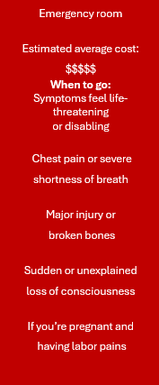
Choose Your Right Healthcare Setting
Virtual care
Estimated average cost: $
When to go: Allergic reactions (minor)
Headache (minor)
Nausea or diarrhea
Cold, cough and sore throat
Sinus pain and fever (minor)
Eye or ear pain or irritation
Burning with urination
Retail health clinic
Estimated average cost: $$
When to go: Allergic reactions (minor)
Bumps, cuts, scrapes, rashes
Burning with urination
Burns (minor)
Cold, cough and sore throat
Sinus pain and fever (minor)
Eye or ear pain or irritation
Shots
Primary care physician
Estimated average cost: $$$
When to go:
Same as retail health clinic plus…
Asthma (mild)
Back pain
Nausea or diarrhea
Headache (minor)
Chronic conditions
Urgent care center
Estimated average cost: $$$$
When to go:
Same as walk-in doctor’s office plus…
Animal bites
Sprains and strains
Stitches
X-rays

Slide 9

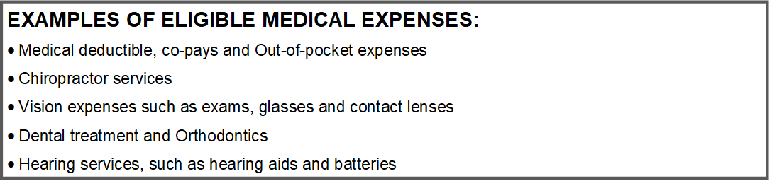
You Can Grow Your Health Savings Account (HSA)
2025 | Single | Family
IRS Maximum Allowed Annual Contribution | $4,300 | $8,550
OWU’s Annual Contribution | $1,000 | $2,000
Catch-Up Contribution (Age 55+) | $1,000 | $1,000
Employee HSA Contribution Advantages:
Employee HSA contributions are pre-tax
Lower your annual taxes by contributing to your HSA
Employee contributions are through payroll
Ohio Wesleyan University’s contributions will get you stared
Maximum Monthly Contribution: $275.00 EE
Maximum Monthly Contribution: 545.83 Family

Slide 10
Employee Additional Savings Account Options:
Tap into the below accounts to cover your out-of-pocket expenses
Options are based on plan design PPO or HDHP/HSA
 | Healthcare Flexible Spending Account | Limited Purpose Flexible Spending Account | Health Savings Account (HSA) | Dependent Care
Medical plan design it pairs with | PPO | HDHP/HSA | HDHP | PPO or HDHP
Use it to pay | Eligible healthcare expenses (medical, dental, vision). Employer can further define. | Eligible dental and vision expenses only | Eligible health care expenses (medical, dental, vision), COBRA premiums, long-term care premiums | Eligible services such as preschool, summer day camp, before and after school programs, and child/adult daycare. Can’t be used on their expenses if both parents aren’t working.
Who contributes | You | You | You and/or your Employer | You
2025 contribution limits | $3,300 | $3,300 | $4,300 employee only $8,550 family | $5,000
Does the balance roll over? | May allow roll over or a grace period, not both. If roll over, allowed up to $660. | May allow roll over or a grace period, not both. If roll over, allowed up to $660. | Yes | May include a 2.5-month grace period to use your money before it is forfeited.
Other information | Funds available first day of plan year. | Funds available first day of plan year. | Portable | Funds available first day of plan year.
Tax Impact | Pre-Tax | Pre-Tax | Pre-Tax | Pre-Tax
Funds | These funds will expire if not used | These funds will expire if not used | These funds do not expire, they roll over | These funds will expire if not used
Contributions must stop 6 months prior to enrollment in Medicare Part A (Age 64 1/2 ) Please notify Human Resources.

Slide 11
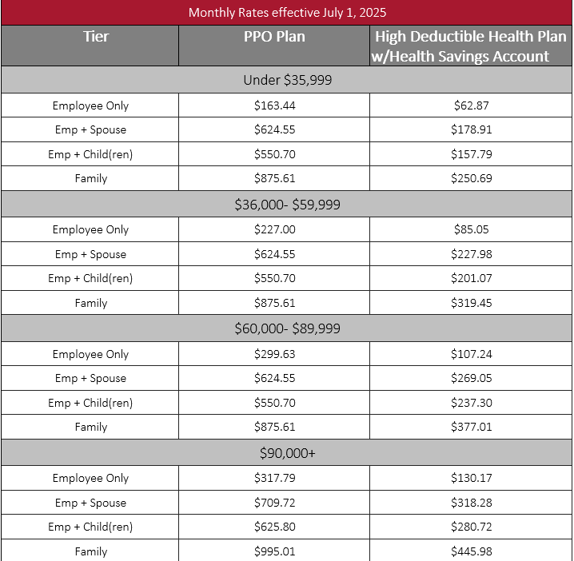
Medical Plan Design Premium Cost Comparison
While Ohio Wesleyan University has one medical plan and provider, Meritain, utilizing the Aetna network. This slide reflects the two different employee monthly premium costs determined by annual pay levels.
PPO Plan: The employer + employee costs are higher
HDHP/HSA: The employer + employee costs are lower

Slide 12
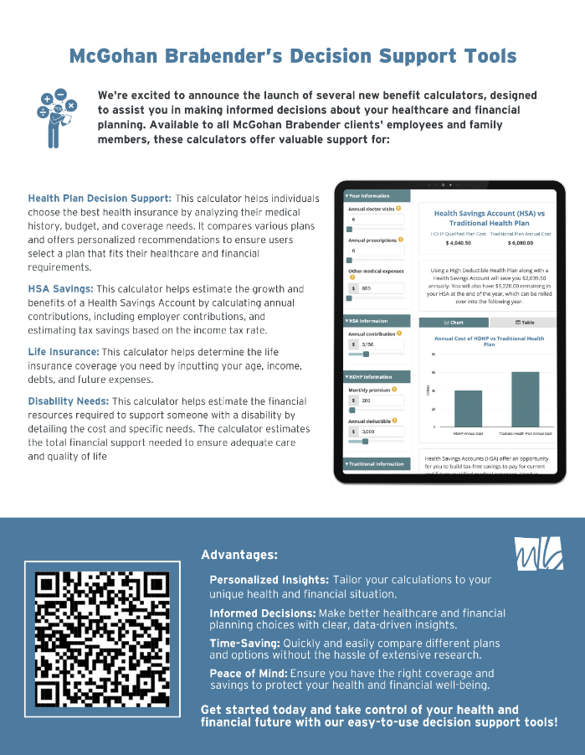
Unsure about changing from the PPO plan design to the HDHP design?
Use this tool to evaluate the cost difference for you!
Scan the QR code to compare plans, utilize your HSA and Life Insurance calculator, and more!

Slide 13



RetireMed
Do you turn 65 during the next 12 months?
Understand your options.
Considering early retirement at age 60, but worried about healthcare?
You have options.
Working at age 65 you have options.
Retirement is not a requirement for Medicare. It is important to compare your group coverage to Medicare once you become eligible to see what is most cost effective. Call Today! 866-600-4266 or email us at advice@retiremed.com
Medicare Alert! HSA contributions must stop 6 months prior to Medicare enrollment.
Here for you for life.

Slide 14


Delta Dental – High Plan
Plan Year | July 1 – June 30
Deductible | $50 Individual / $150 Family
Preventive Services (Teeth cleanings, oral exam, and routine x-rays) | Plan pays 100%
Basic Services (Fillings, simple extractions) | Plan pays 90%
Major Services (Dental crowns, bridges, implants, and root canals) | Plan pays 60%
Annual Maximum per person | $1,500
Orthodontics (dependents under age 19) | Plan pays 50%
Ortho Lifetime Maximum | $1,000
Dental Plan (High)
Dental | Your Monthly Cost
Employee | $43.62
Employee + 1 | $86.43
Family | $140.52

Slide 15
Delta Dental – Low Plan
Plan Year | July 1 – June 30
Deductible | $50 Individual / $150 Family
Preventive Services (Teeth cleanings, oral exam, and routine x-rays) | Plan pays 100%
Basic Services (Fillings, simple extractions) | Plan pays 80%
Major Services (Dental crowns, bridges, implants, and root canals) | Plan pays 50%
Annual Maximum per person | $1,000
Orthodontics (dependents under age 19) | Not covered
Ortho Lifetime Maximum | Not covered
Dental Plan (Low)
Dental | Your Monthly Cost
Employee | $31.21
Employee + 1 | $61.20
Family | $99.98

Slide 16


EyeMed – Core Plan
Plan Year | July 1 – June 30
Routine Vision Exam | $20 copay
Contact Lenses | $130 Allowance on contact lenses and frames and $180 allowance for PLUS providers (with 20% off any balance for frames)
Lasik | Discount Available (please consult with your doctor)
Frequency: Exam/Frames/Lenses | Exam: Every 12 Months Frames & Lenses: Every 24 Months
Vision Plan
Vision | Your Monthly Cost
Employee | $4.32
Employee & Dependents | $12.21

Slide 17
EyeMed – Buy-Up Plan
Plan Year | July 1 – June 30
Routine Vision Exam | $10 copay
Contact Lenses | $140 Allowance on contact lenses and frames and $190 allowance for PLUS providers (with 20% off any balance for frames)
Lasik | Discount Available (please consult with your doctor)
Frequency: Exam/Frames/Lenses | Exam: Every 12 Months Frames & Lenses: Every 12 Months
Vision Plan
Vision | Your Monthly Cost
Employee | $5.74
Employee & Dependents | $16.22

Slide 18


Your Employee Assistance Program with Guardian
Why people use EAP:
Emotional problems
Stress
Marital or family conflict
Drug or alcohol problems
Other addictive behaviors
Grief
Caregiving responsibilities
Legal or financial problems
Other personal issues
At times we all experience challenges at work or at home that affect our well-being and make it difficult to concentrate on our daily tasks. An EAP provides short-term counseling and referral services to help you address these challenges.
Confidential to Ohio Wesleyan University
Free to employees and their covered dependents living in their household
Available around the clock every day of the year
Your EAP benefit is 100% employer paid

Slide 19


Basic Life and AD&D
Financial protection for your dependents if anything were to happen to you
Basic Life and AD&D : 100% Employer Paid Ohio Wesleyan University provides Basic Life Coverage for all full-time employees.
Employee Volume Amount: 200% of annual earnings to $250,000.
Maximum Amount: $250,000
Cutbacks: 50% at age 75
AD&D:
Volume Amount: 300% of annual earnings to $500,000
Guaranteed Issue Amount: Your Accidental Death and Dismemberment coverage is guaranteed based on your Basic Life coverage
Maximum Amount: $500,000
Cutbacks: 50% at age 75
Revisit your beneficiary designations annually or whenever there is a life event.
Beneficiary distributions must equal 100%. Your primary beneficiary refers to who will receive your death benefit when you pass away. Your secondary beneficiary refers to who will receive your death benefit if your primary beneficiary has also passed away.
Ohio Wesleyan University’s benefit offers free Will Prep. See the enrollment guide for details.

Slide 20
Short-Term and Long-Term Disability
Short-Term Disability: 100% Employer Paid Income protection intended to cover you immediately following a serious illness or injury.
Weekly Volume: 70% of weekly earnings
Maximum Amount: $1,000
Waiting Periods: Accident – Day 8, Illness – Day 8
Maximum Payment Period: 25 weeks
Long-Term Disability: 100% Employer Paid Income protection if your condition keeps you out of work past the end of your short-term disability benefit period
Monthly Volume: 60% of monthly earnings
Maximum Amount: $6,000
Waiting Periods: Accident – Day 181, Illness – Day 181
Maximum Payment Period: Social Security Normal Retirement Age

Slide 21


VOYA - Voluntary Worksite Benefits
Additional dollars to help cover life’s unexpected health care expenses.
No open enrollment action is required if you choose to continue with the same coverage!
Critical illness insurance delivers an added layer of financial security by paying a lump-sum benefit when a serious diagnosis strikes. Covered conditions usually include cancer, heart attack, stroke, major organ failure and end-stage kidney disease.
Accident insurance helps offset the cost resulting from an unforeseen injury. Payable benefits often include ER visits, fractures, hospital stays, diagnostic exams, emergency transportation and more.
Hospital indemnity provides a cash benefit upon admittance for a covered hospital stay. These plans help to cover cost for labor/delivery, surgery, and confinement as a result of an accident or illness.
Claims are paid directly to employee
You can take the products with you if you leave the company
Evidence of insurability may be required for late enrollment or if you wish to increase your current selection(s)
Benefits are post-tax

Slide 22
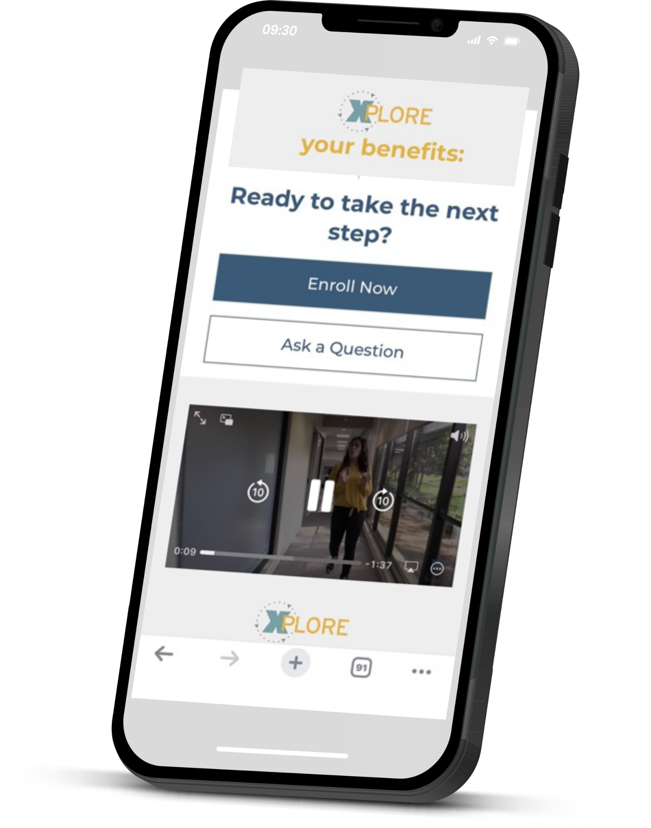


Benefit Information on YOUR Time
Benefit overviews
Video tutorials
Premium costs and important plan documents
Tips & valuable hacks to get the most out of your plan
Access MB Perks discount program
Contact information for the MB Advocate Team
Scan the QR code to explore your benefits hub!
Or visit the below link:
https://xplore.mbbenefits.com/9afd0131-4a9c-498a-ad38-5193e467af91

Slide 23


Discount Options Galore!
ADP – LifeMart - Hundreds of discounts available
Employees can log on to the ADP site: at https://portal.adp.com or using the single sign on access at: OWU single sign on , and look for the "Employee Discounts: LifeMart" on the home screen.
Available Discounts include: Retail, Travel, Hotels, Tickets, Electronics, Auto, Grocery & Food Delivery, Apparel, Car Rental, Books & Magazines, Home, Wellness, Theme Parks
local coupons
movie showtimes

Slide 24






Discount Options Galore!
MB Perks
local coupons
etickets
monthly giveaways
Real savings with no hidden fees.
Enjoy member-only discounts and corporate rates on everything from pizza and the zoo, to movie tickets, car rentals, and hotels. With thousands of local and national offers across 10,000 cities and easy mobile access, you’ll always have a reason to Celebrate Your Savings!
mobile apps
movie showtimes
perk alerts
holiday offers
Register & Login – http://mbperks.com/GO

Slide 25


MB Advocates
For all the “when’s,” we got your back
When you…
Encounter a claims issue
Receive an EOB (Explanation of Benefits) that you don’t understand
Receive a bill from a provider that makes no sense
Are coordinating benefits with another carrier
Run into problems with a pre-authorization
TALK TO A REAL PERSON WHO UNDERSTANDS YOUR SITUATION AND CAN HELP
MONDAY – FRIDAY 8AM – 5PM EST
When you contact the MB Advocates, have your insurance card, copies of paperwork or correspondence, including names, dates, EOBs and bills.

Slide 26

Next Steps
01. Review
Review your materials, identify your plan selections as well as any to-do’s you may have to complete (evidence of insurability) with your enrollment selections.
02. Select
Go to ADP to make your benefit selections. Be sure to check your beneficiaries for any changes that need to be made.
https://www.owu.edu/adp
03. Deadline
May 31st, 2025, will be the deadline for completing enrollment.
*Please note, this fall OWU will be conducting a dependent verification, please be prepared to show proof of spouse/child eligibility*

Slide 27


Questions?

Slide 28

One Final Reminder
Open Enrollment Begins:
May 21st and ends May 31st

Slide 29

Future Events:
Ohio Wesleyan University’s Employee Health + Wellness Fair
Understanding Your Benefits Sessions. Keep an eye out for dates in the fall and spring!
RetireMed Sessions
Join these sessions to maximize your knowledge around your benefits.

