Slide 1
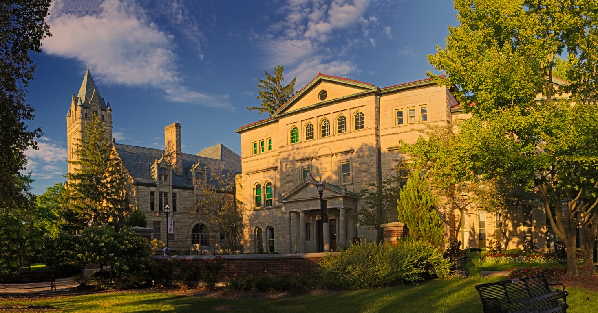
OWU Community Standards

Slide 2
OWU Guiding Principles
We value the interests and concerns of all members of our community.
We honor the commitments we make.
We respect and appreciate every person.
We demonstrate excellence by doing our best in all circumstances.
We support others by listening, being accessible, and providing timely responses.
We solve problems through positive, engaged interactions.

Slide 3
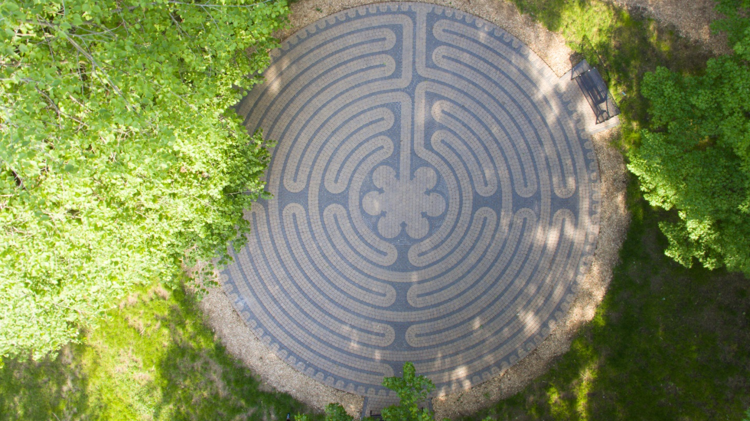
OWU Community
Standard #1
I take pride in being a valuable member of the OWU community and represent the University appropriately at all times.

Slide 4
OWU Community
Standard #2
I start from a position of “How can I help?” I am respectful, authentic, and empathetic. I provide assistance and collaborate with others to resolve issues.

Slide 5
OWU Community
Standard #3
I take responsibility for supporting the mission and goals of the University and my department. I make decisions within my expertise and authority, and entrust everyone to do the same.

Slide 6
OWU Community
Standard #4
I understand the importance of clear, transparent, and regular communication. I commit to sharing and receiving information appropriately.

Slide 7
OWU Community
Standard #5
I recognize and value diversity and inclusivity within the OWU community.

