Slide 1
Bishopbuy, Concur Travel & Expense
& Procurement Card Training

Slide 2
Card Information
Before you can use your card for any purchases, you must activate it. Call the number on the sticker on the front of the card. Your birth year should be your activation code.
If you have an issue or your card is not working, call the number on the back of the card.
If your card has been lost or stolen, call JPMorgan Chase immediately at 1-800-316-6056.
Your default card limit is $5,000 per month with a $2,000 single transaction limit. If for some reason you need this increased, email the Purchasing department and copy your supervisor.

Slide 3
Unauthorized Transactions
Cell phones or monthly cell phone service
Controlled substances
Donations
Fines and penalties
Gambling
Gift cards
Guns, weapons, ammunition or explosives
Hazardous chemicals
Illegal transactions
Internet connectivity unless traveling on university business
Personal items, services, or expenses

Slide 4
Restricted Product Classes
Amazon – All Amazon transactions must be purchased through our Amazon Business Prime account in Bishopbuy. Your transactions will be charged to a single ghost card and you will not have to clear them in Concur. This account features all the regular benefits of Prime plus tax exemption.
Office supplies – We use Amazon Business Prime or Friends. Both are found in Bishopbuy.
Printing and stationery - We have contracted pricing through Kenwel Printers via Bishopbuy if items are not being printed by Duplicating
Catering on campus - AVI has the first rights of refusal
Computer and software purchases MUST be run through Purchasing and IT via a BishopWorks ticket to ensure items meet the systems we use on campus
Office furniture
Goods that require contracts
Professional services
Promotional materials
Replacement items
Long-term rentals (2 months or longer)
Items to be capitalized (items worth $5,000 or more)

Slide 5
Purchases
Do NOT divide one purchase into two or more transactions to stay within your single transaction limit.
Do NOT receive cash back for refunds or exchanges. Refunds should be credited directly to your P-card.
Do NOT allow others to use your card under any circumstances.

Slide 6
Tips
Know who and where you’re ordering from
Watch delivery dates and in-stock availability
Check for preferred vendors (vendors we use regularly who have provided us competitive pricing, hassle free delivery, and quality products)
  Ask Purchasing for recommendations!
Don’t pay sales tax – we are tax exempt in several states!
Delivery address for Central Receiving:
  Central Receiving
  Attn: Your Name
  28 Hayes St.
  Delaware, OH 43015

Slide 7
Disputing a Charge
Contact the vendor first if you need to dispute a charge.
If after two weeks the vendor has not corrected the charge, you should contact Chase.
At this point, Chase will further investigate the disputed charge and grant a provisional credit for the disputed item.

Slide 8
Benefits of Concur Travel and Expense
Integrated travel and expense system
Single sign-on
  Log into Concur using your OWU user ID and password
Mobile capabilities
  Book travel and submit/approve expense reports via your mobile device (iPhone/iPad and Android)
Link personal travel rewards programs and save preferences for travel
Electronic capture of receipt images
  Users can take photos of receipts using their phone and email them easily to Concur
  Receipts from some vendors may automatically feed into Concur (i.e. Uber)
Incorporates OWU’s policies and guidelines

Slide 9
How to Access Concur
Concur can be accessed from:
  my.owu.edu
  https://www.owu.edu/about/offices-services/office-of-finance-administration/purchasing-department/concur-travel-expense/
Log in using your OWU user ID and password

Slide 10
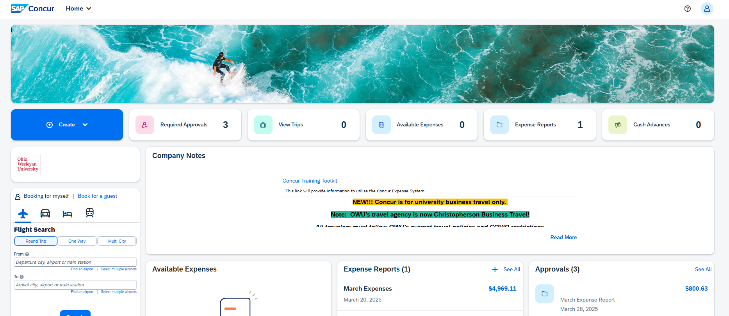
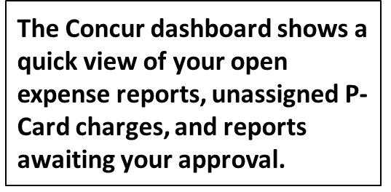
Concur Dashboard

Slide 11
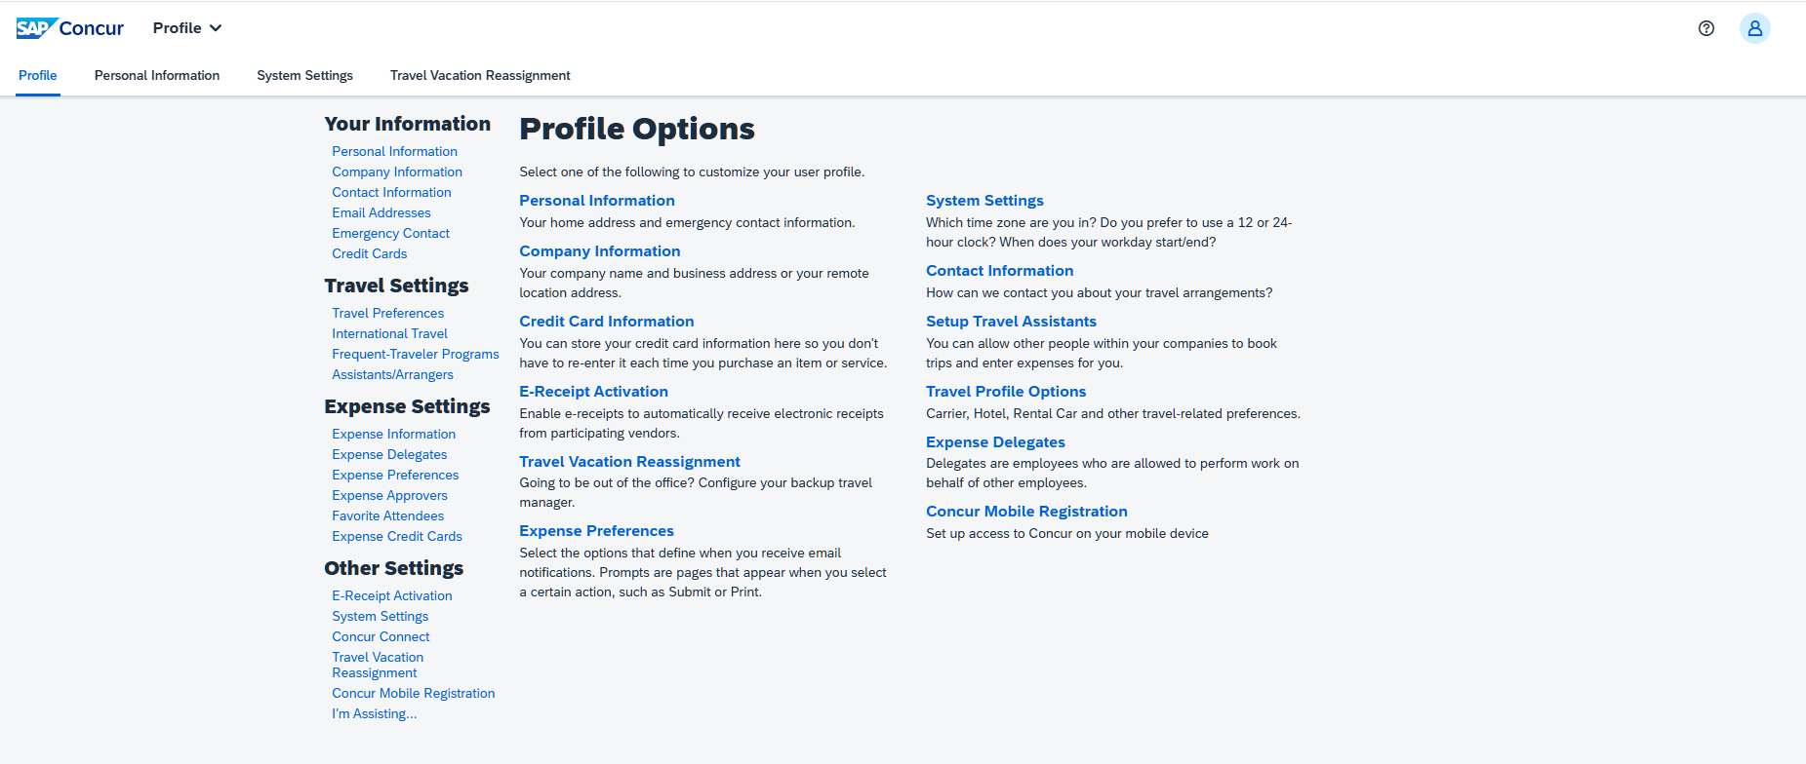
Updating Your Profile Settings
When logging into Concur for the first time users should go to the Profile Settings screen to update their personal information. Make sure you:
Verify that your name matches your legal ID
Verify your email address (it will email a code to you that you copy and paste into the profile settings)
Register your mobile device for risk management
Adjust your travel preferences
Add expense delegates and/or travel assistants if needed

Slide 12
Creating an Expense Report
Concur allows users to create their own expense reports with ease
P-card charges are automatically loaded from Chase into a user’s account
Out-of-pocket charges (personal cards or cash) can be entered manually on the website or through the Concur mobile app
Receipts can be entered by using the Concur app, by emailing them to your account, or by uploading them from your desktop
  Some receipts may also push through Concur automatically from the vendor

Slide 13
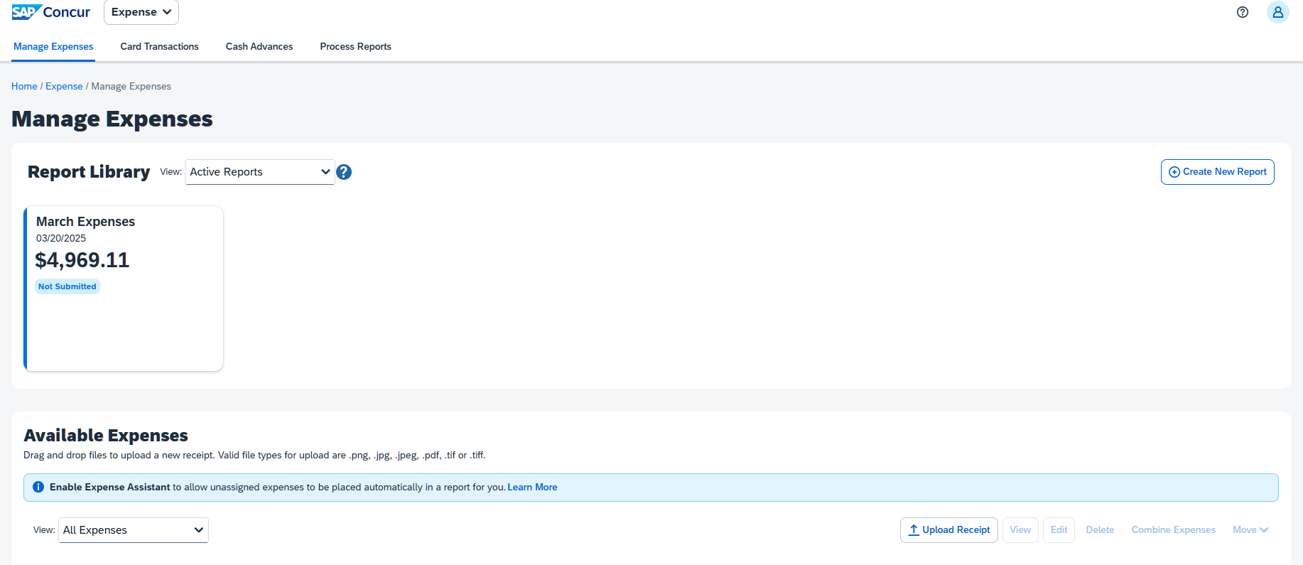
Expense Report Dashboard
The Expense screen allows you to create a new report, access open or returned reports, and view or recall submitted reports. You can view all reports you have previously submitted as well. You can also view expenses that have not been assigned to a report under Available Expenses.

Slide 14
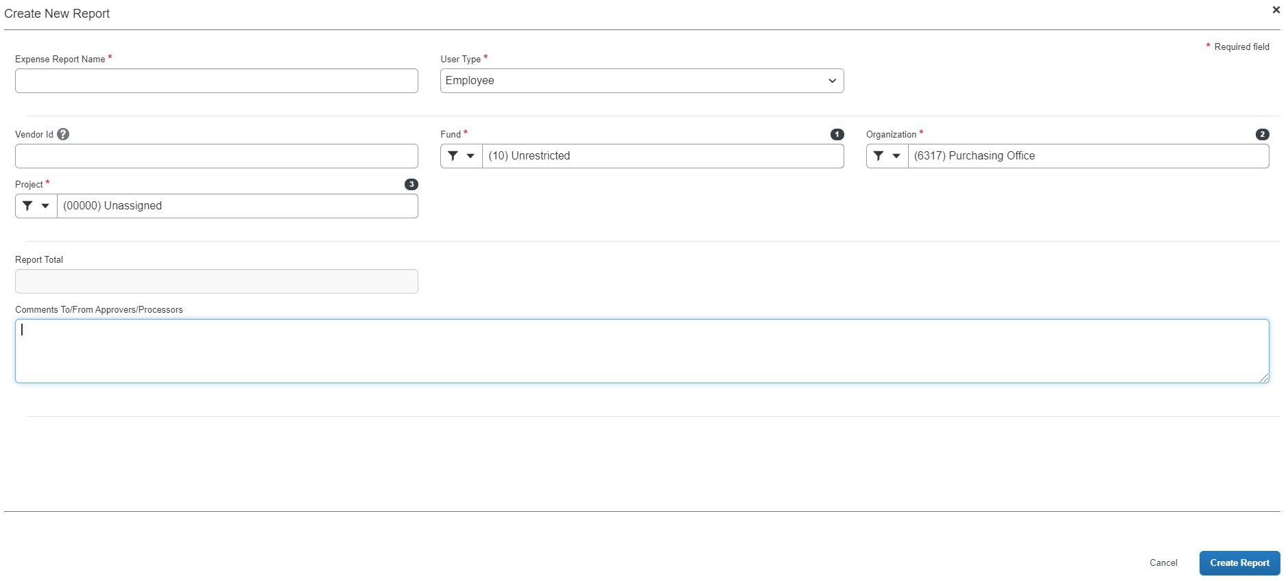
Expense Report Header
The required fields have a red asterisk next to them. The user type defaults to Employee, but can be modified to Guest or Student if one of those individuals is being reimbursed. Each employee has a default account number that expenses will be charged to unless they are allocated otherwise. Please contact Purchasing if you would like your default account number changed. We suggest submitting an expense report for each month’s expenses as expenses need to be cleared within 30 days.

Slide 15
Reimbursing Guests and Students
Guests and students are also reimbursed via Concur. The process of adding out of pocket transactions to a report is the same as it is for an employee, but the report header must be modified so that the system knows to send payment to the guest or student.
In the report header, modify the User Type to Guest or Student rather than Employee. A box will appear to enter a vendor ID. For students, this is their OWU ID number. For guests, a vendor ID number must be obtained from the Purchasing office.
You can enter reimbursements for multiple people on the same expense report, but make comments by each transaction so that Accounting knows which guests are being reimbursed for which expenses.

Slide 16
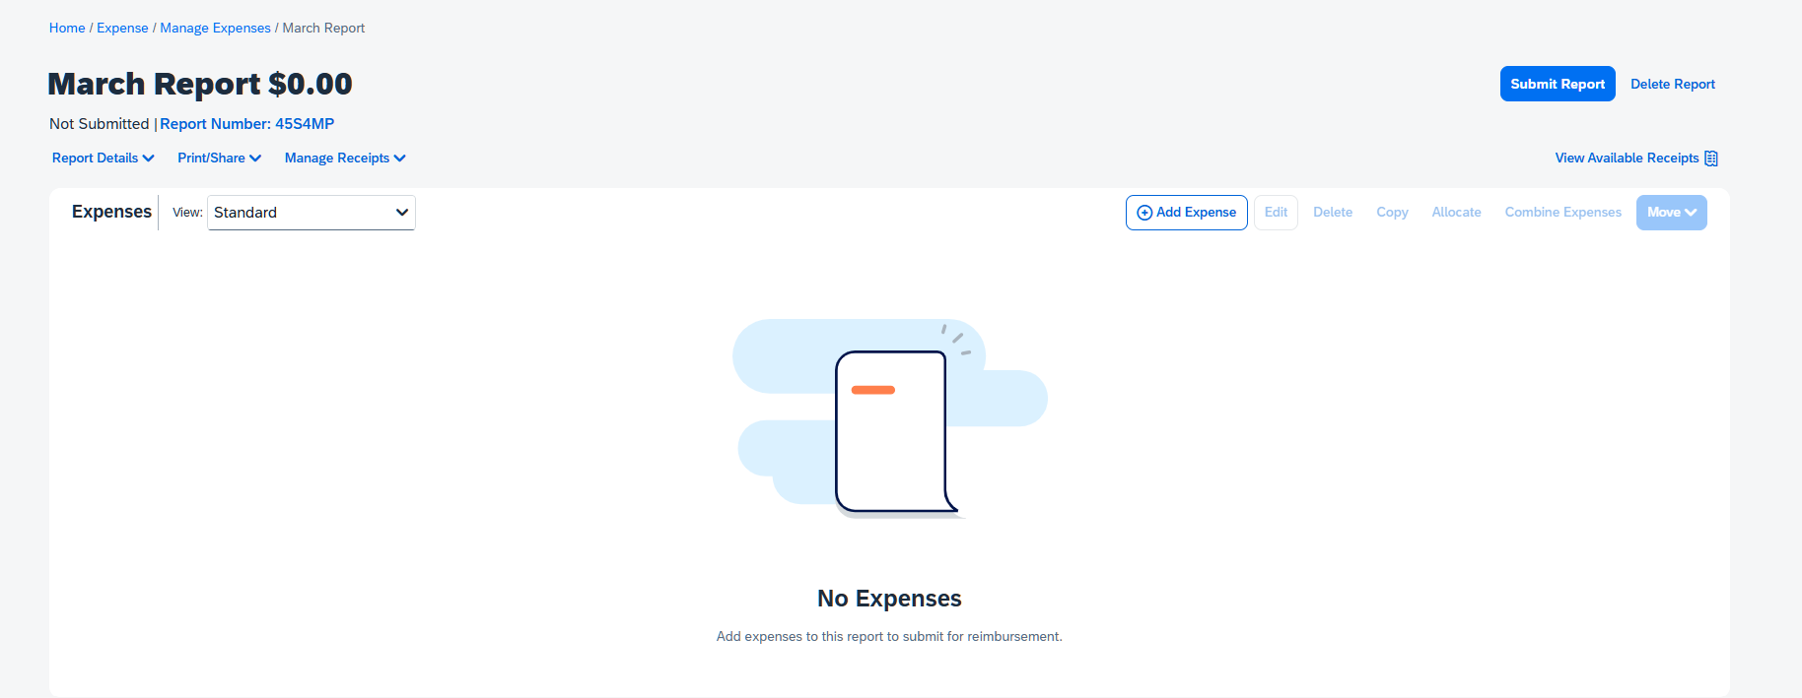
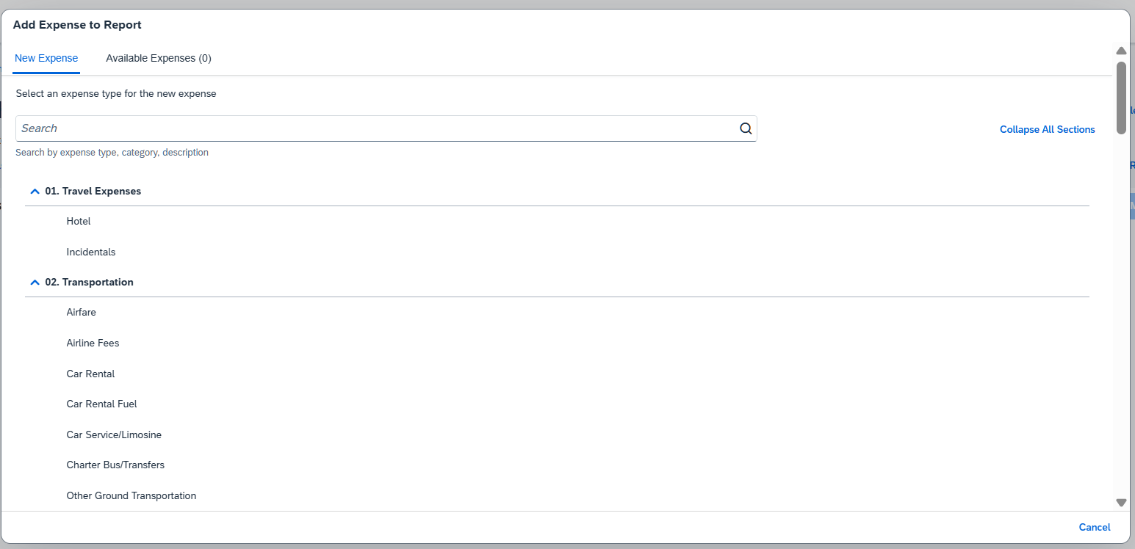
Adding Expenses to a Report
To add P-card charges to an expense report, you can add them from the Available Expenses page, or by clicking Add Expense. This is also how you add Out of Pocket expenses. The expense type is autopopulated from the vendor but can be modified.

Slide 17
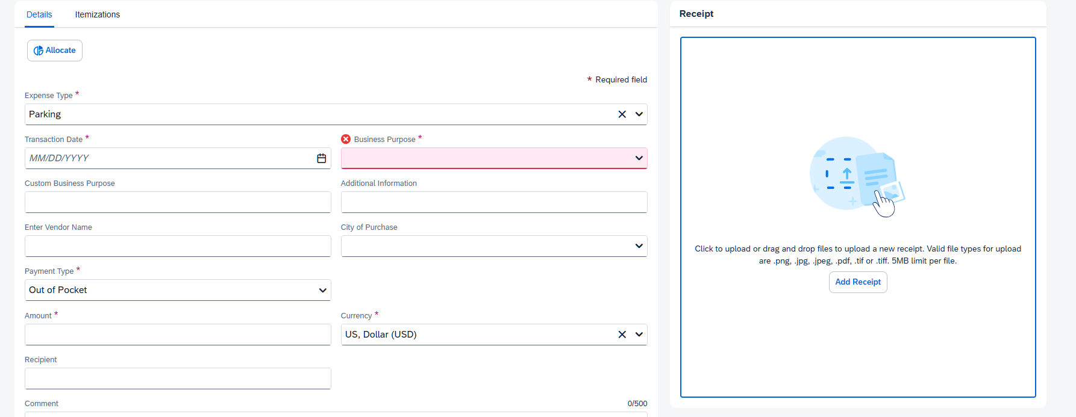
Entering Expense Details
Different expense types require different details. Any field that is required is marked with a red asterisk. The fields may begin to autopopulate as you use the system more. After adding or editing any required information, you can click Save Expense and attach a receipt from your Available Receipts (those that you may have sent via email, the Concur app, or automated from the vendor) or you can attach one from your desktop.

Slide 18
Other Report Information
The system uses symbols to provide information. If you click on the symbol it will tell you more about its meaning. Typically red exclamation marks will prevent you from submitting a report. Yellow hazard signs may indicate that two expenses are similar.
You do not need to assign object codes
  Concur assigns the object codes based on the expense type of your transaction
Transactions will default to the account number entered in the report header, but they can easily be allocated to another account or split between multiple accounts based on percentage or dollar amount
Certain expense types require itemization (hotels, meals with alcohol)
Concur has a built-in exchange calculator when entering out-of-pocket charges in a foreign currency
The system will not allow you to submit out-of-pocket payments when you have outstanding P-card charges. All reimbursements and P-card expenses must be submitted within 30 days.

Slide 19
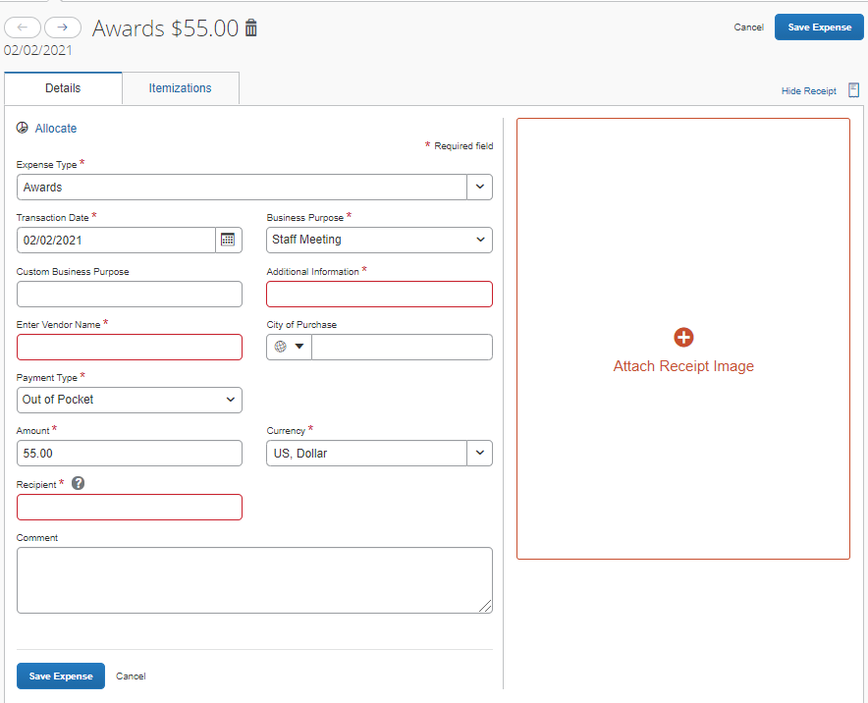
Supporting Details
Some expense types require additional details based on IRS requirements. For instance, Awards and Flowers/Gifts/Memorials require a recipient’s name. We also ask for a vendor name and additional information.

Slide 20
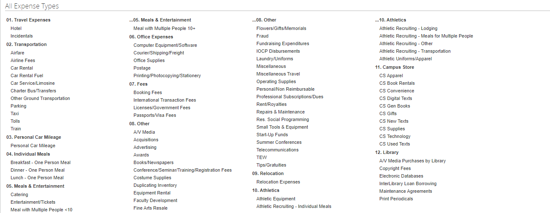
Individual Meals
Whenever you had a meal by yourself, you will choose from the following expense types:
  Breakfast – One Person Meal
  Lunch – One Person Meal
  Dinner – One Person Meal

Slide 21
Meals with Multiple People
When you dine with other people or purchase a meal for someone other than yourself, you will choose one of the expense types titled Meal with Multiple People.
There are two options:
  Meal with Multiple People <10
    Use this expense type when there were less than 10 people at the meal
  Meal with Multiple People 10+
    Use this expense type when there were more than 10 people at the meal

Slide 22
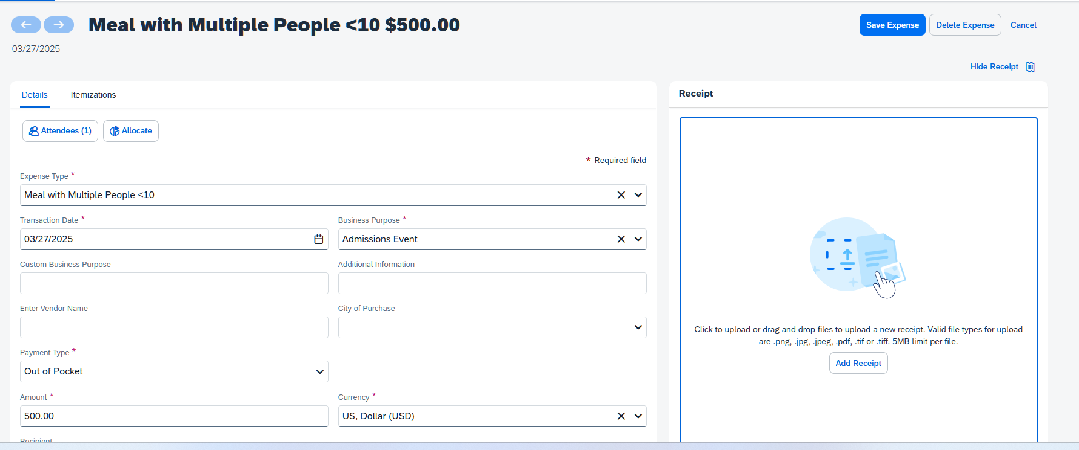
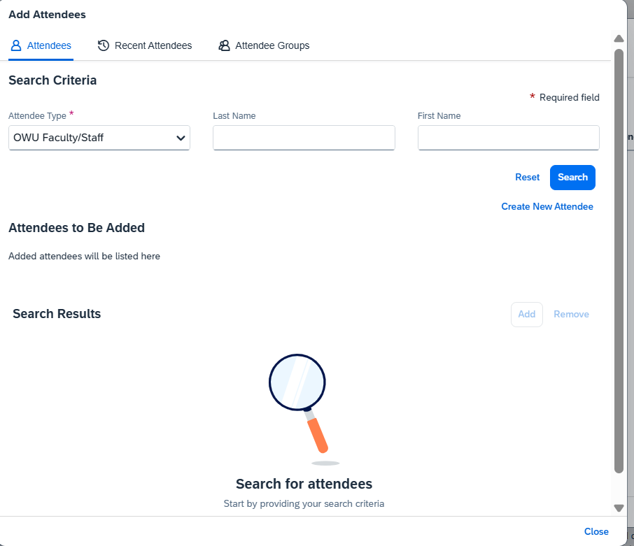
Meal with Multiple People <10
When there are less than 10 people at a meal, we need to know their individual names per IRS guidelines.
You will add the attendees by clicking Attendees, then by clicking Add in the popup, and by searching among Faculty/Staff, Student, Recent Attendees, or by clicking the link to create a New Attendee.
You can also create groups (useful for teams or classes).
Continue adding attendees until all names have been added.

Slide 23
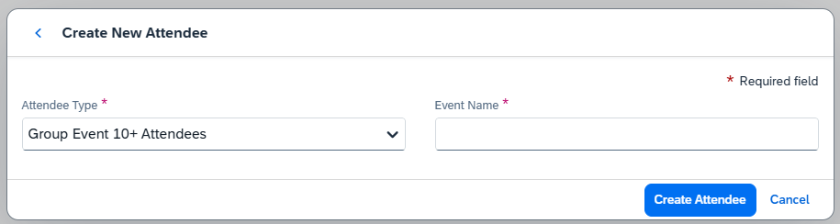
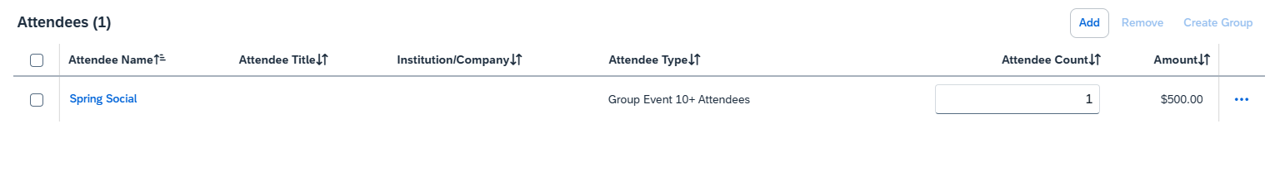
Meal with Multiple People 10+
When there are more than 10 people at a meal, you can create an event name and specify how many people were there rather than adding the attendees individually.
Click the Attendees button, find the link to create a New Attendee and create an event name, then click Create Attendee.
Then modify the Attendee Count box with the number of attendees, and click Save.

Slide 24
Athletic Meals
If you had a meal for a team, you will use one of the Meal with Multiple People expense types.
If you had a meal while recruiting, you will use either:
  Athletic Recruiting – Individual Meals
  Athletic Recruiting – Meals for Multiple People
  These expense types will use the same fields as the other meal expense types.

Slide 25
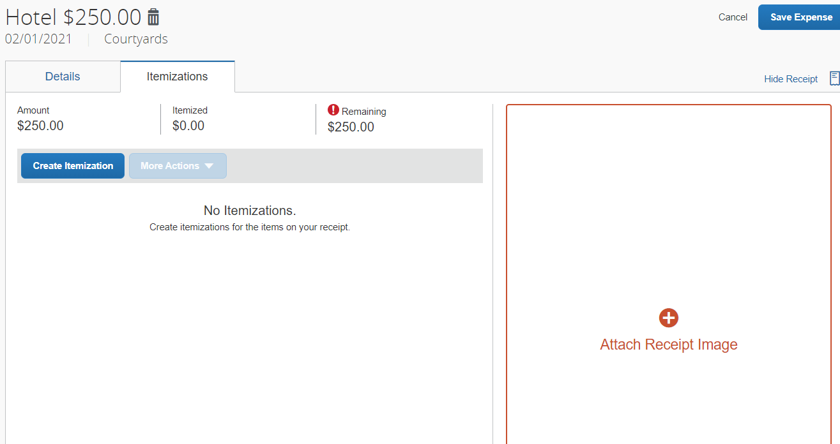
Itemizing Expenses
For hotels and meals with alcohol, or expenses that you need to split between expense types, you will itemize. Click on the Itemizations tab and then click Create Itemization. For hotels, we need you to separate out hotel tax from the room rate and any incidentals or meals that were also on the bill.
The system will not let you save the expense until there is $0.00 remaining.

Slide 26
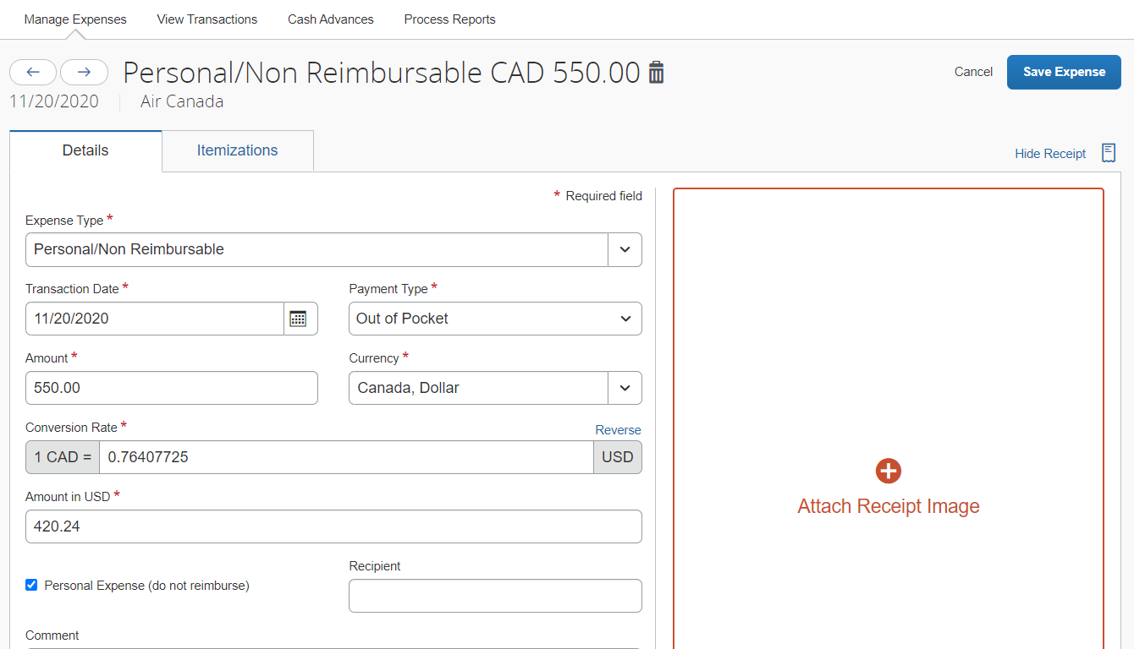
Personal/Non-Reimbursable Expenses
If you accidentally used your P-card for a personal expense, modify the expense type to Personal/Non Reimbursable and bring a check for the amount of the transaction to the Accounting office.
If you make a P-card purchase that is against policy, the approver or processor can mark the expense Personal/Non Reimbursable and require repayment to the university.

Slide 27
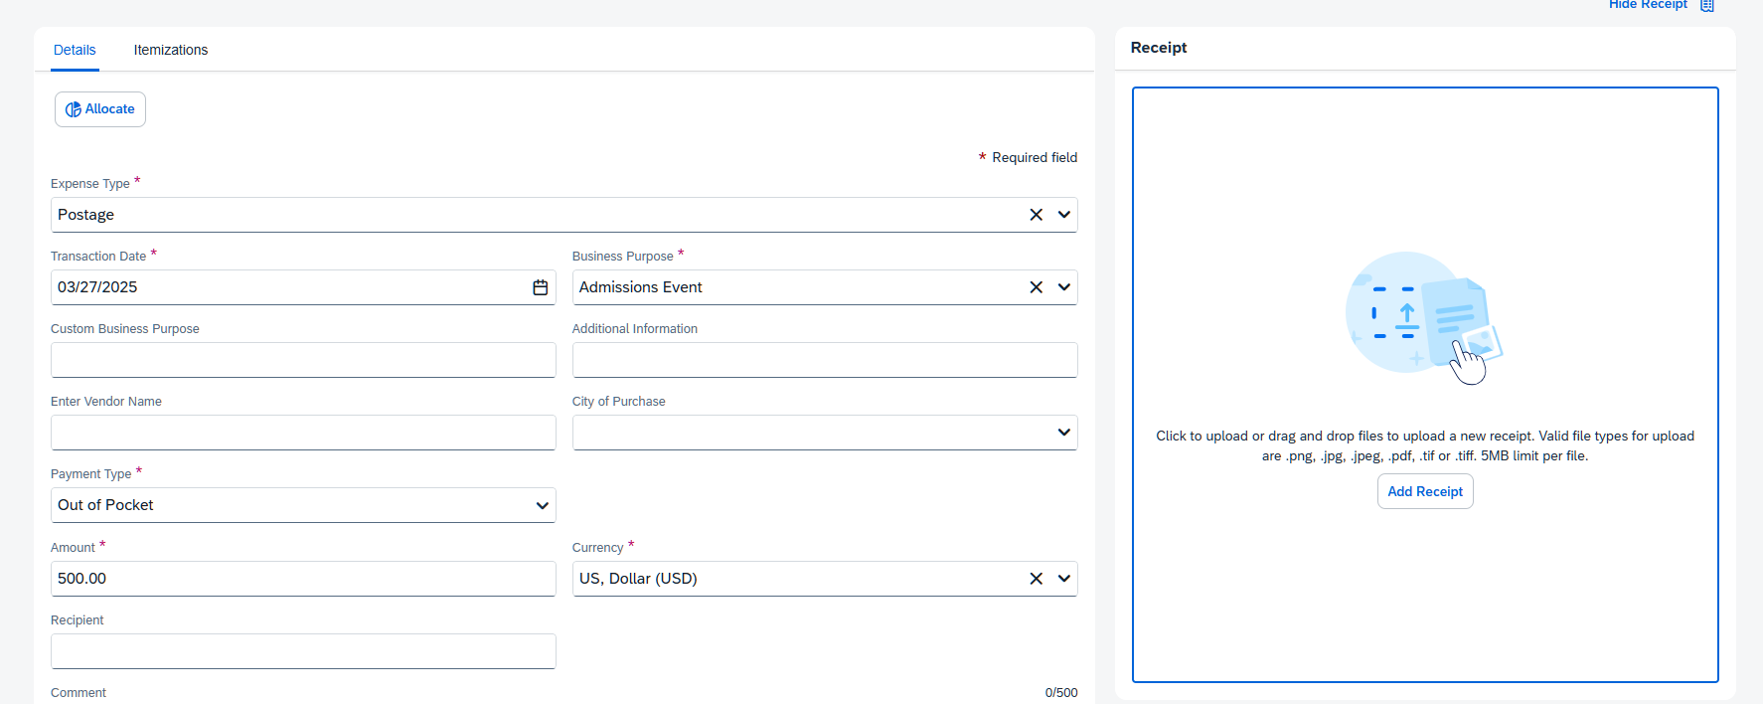
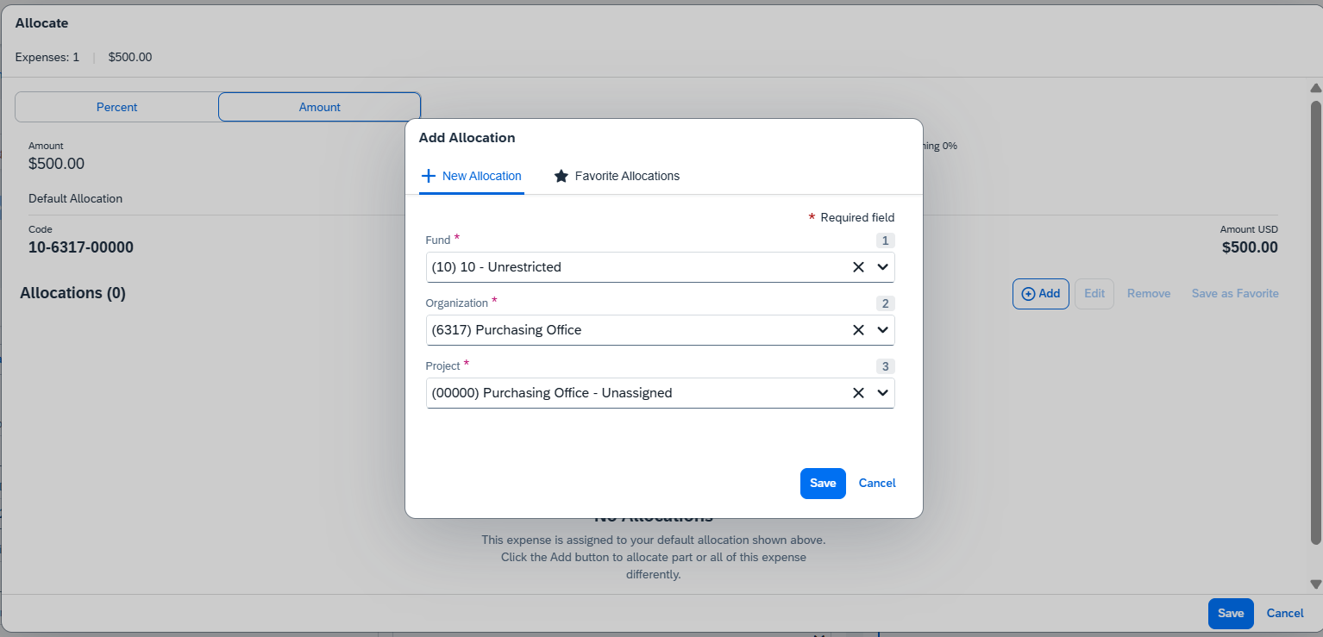
Allocating Expenses
There may be times you need to charge one transaction to a different account number or split a transaction between multiple account numbers. Click on the transaction then click the Allocate link. You will see a screen that looks like this. You can click Add to add a new allocation. You can split a transaction by percentage or dollar amount and can save your favorite allocations. Type your account number in the Fund, Organization, and Project drop downs and choose the correct account number segment from the list that appears. Then click Save.

Slide 28
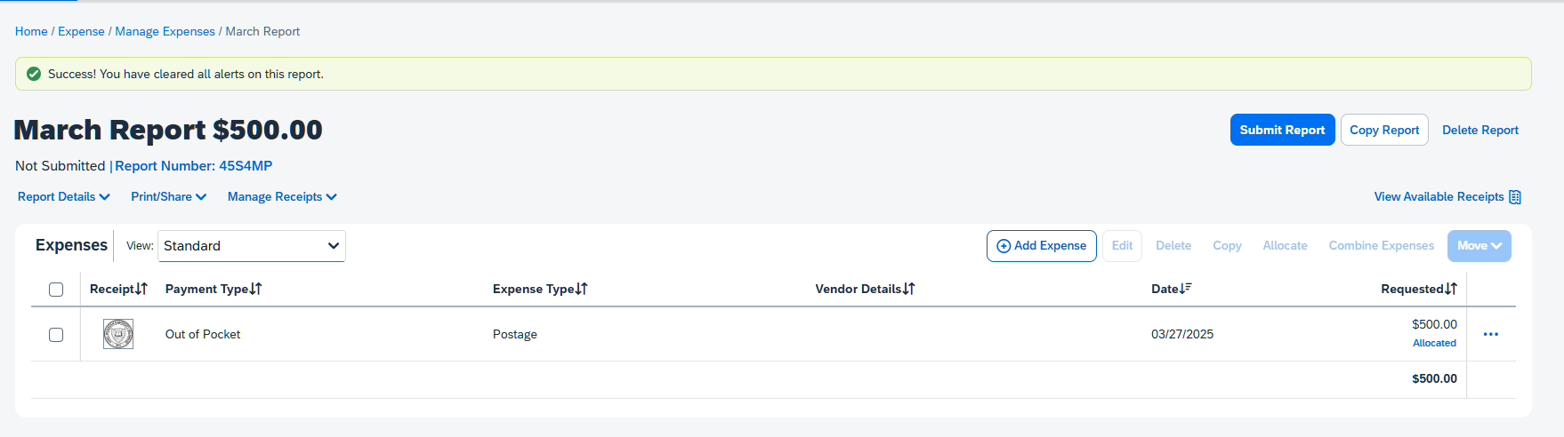
Viewing Allocations or Itemizations
After allocating an expense, you can view the account number details by clicking on the blue “Allocated” text. This text appears whenever a line is charged to an account different than the account number that was entered in the report header. When a report that contains an allocated expense is submitted, it will be approved by your default approver, then it will go to the cost object approver for that account number. The cost object approver will only be able to see the transaction charged to their account number.
You can view itemizations in the same manner.

Slide 29
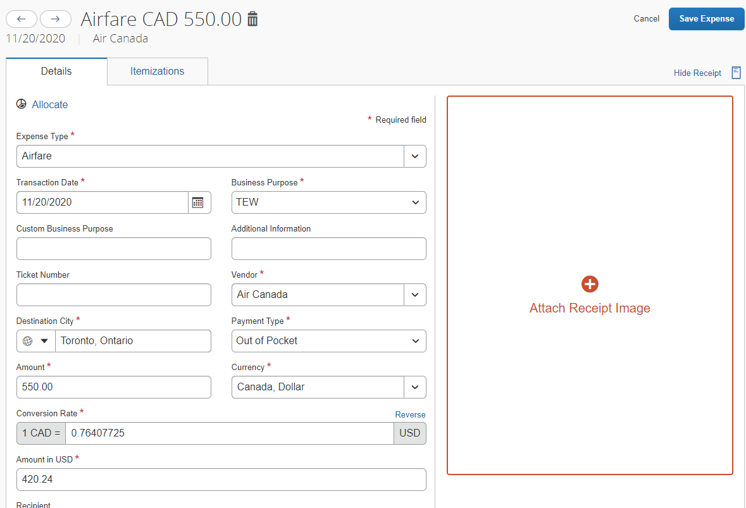
Expenses in Foreign Currencies
Charges made in foreign currency on your P-Card will automatically convert to USD. When adding an out-of-pocket expense in a foreign country, Concur will automatically add the exchange rate based on the date and location.

Slide 30
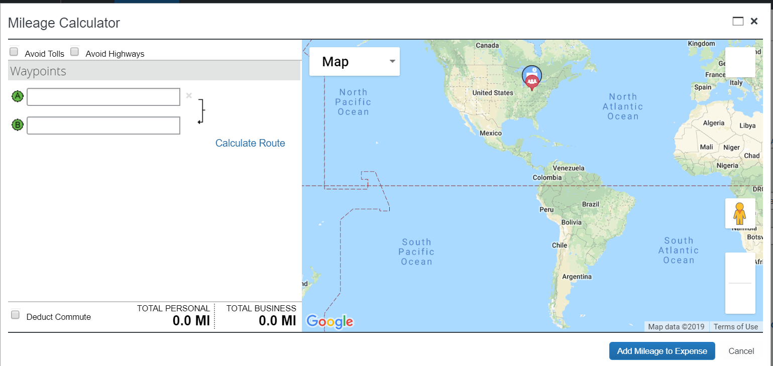
Calculating Mileage
When entering a mileage reimbursement, choose Personal Car Mileage as the expense type then click on the Mileage Calculator. It will bring up a screen for you to enter the locations and automatically calculate your reimbursement for you. You can make your trip round trip and also deduct your commute. This Mileage Calculator is considered your receipt.

Slide 31
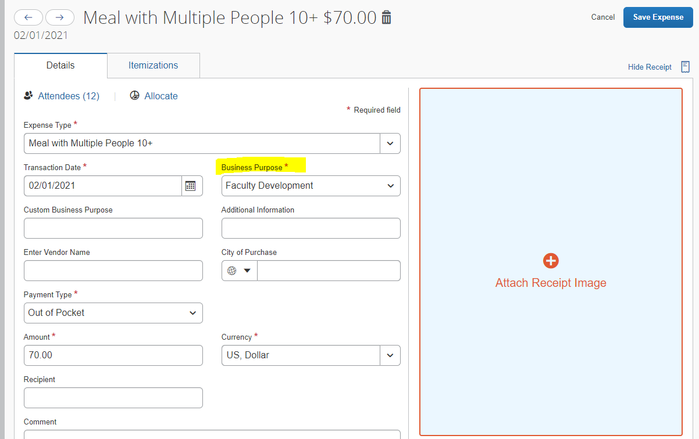
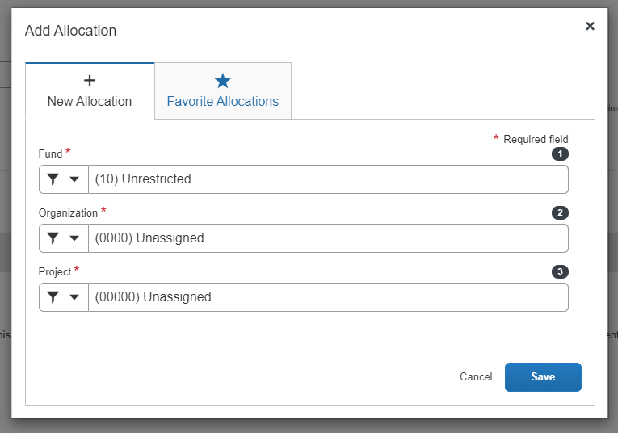
Using Faculty Development, TEW, or Start-Up Funds
If you are charging an expense to your faculty development, TEW, or Start-Up funds, modify the Business Purpose to one of those categories. Then, allocate the transaction if it is different than the account number entered in your report header. For faculty development, you will not need to enter your analytical code, as it is tied to your profile behind the scenes. If you are charging an expense to someone else’s faculty development account, please put the person’s name in the Additional Information box.
Account numbers to allocate to:
Faculty Development: 10-0000-00000
TEW: 10-0000-XXXXX (obtain your specific project code from the Provost’s office)
Start-Up Funds: 10-0000-XXXXX (obtain your specific project code from the Provost’s office)

Slide 32
Importing Receipts
Use the Concur mobile app to take photos of your receipts
  Photos taken in the app are uploaded to the account associated with that phone
Send the receipt by email to receipts@concur.com or receipts@expenseit.com
  The email must come from a verified address (done in Profile Settings)
  .png, .jpg, .jpeg, .pdf, .html, .tif, and .tiff files are all accepted
Upload receipt images from your desktop to your account
If your receipt has been misplaced and all other methods of obtaining a receipt have been exhausted, a missing receipt affidavit can be electronically filed
Mileage, tips, tolls, booking fees, international transaction fees, fraud, and parking under $5 do NOT require receipts

Slide 33
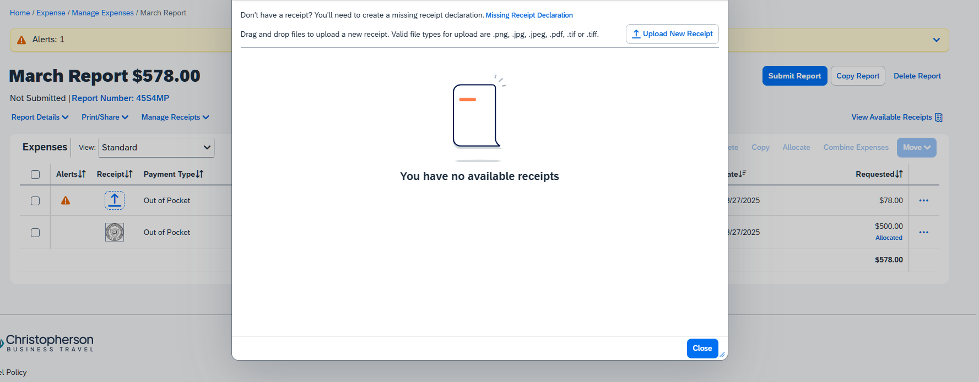
Attaching Receipts
You can click on the receipt column next to your expense to add a receipt. Your available receipts (those you’ve uploaded via phone or email) will appear as picture icons. On the expense level, click Attach Receipt Image, and then click Attach underneath the receipt image. Concur may also try to automatically match the receipt to the transaction for you. If you do not like the matching, you can turn that ability off in your Profile Settings.

Slide 34
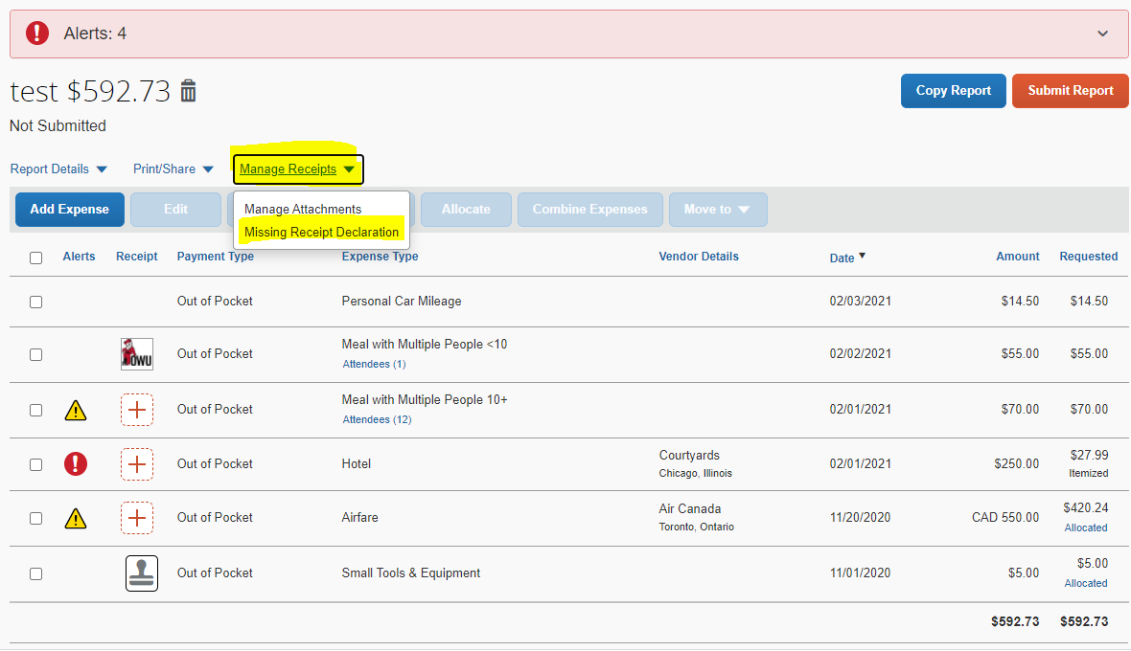
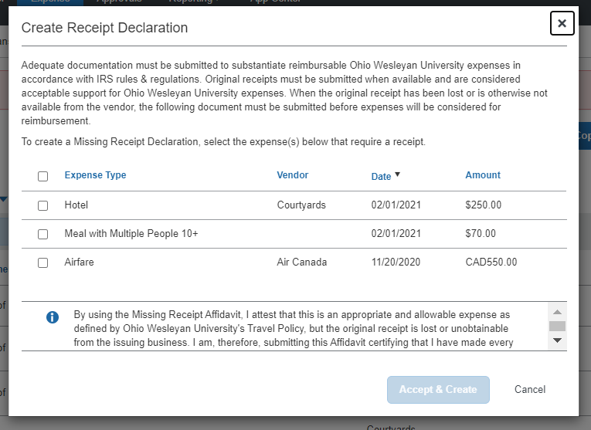
Using the Missing Receipt Affidavit
We now use electronic missing receipt affidavits. Within the report, click Manage Receipts, then Missing Receipt Declaration. You can then check the boxes to the left of the expenses you are missing a receipt for, and click Accept and Create.
Before uploading a missing receipt affidavit all avenues of obtaining a receipt should be exhausted.
Some expense types will not accept a missing receipt affidavit (i.e. hotels).
No one can submit a missing receipt affidavit on your behalf.

Slide 35
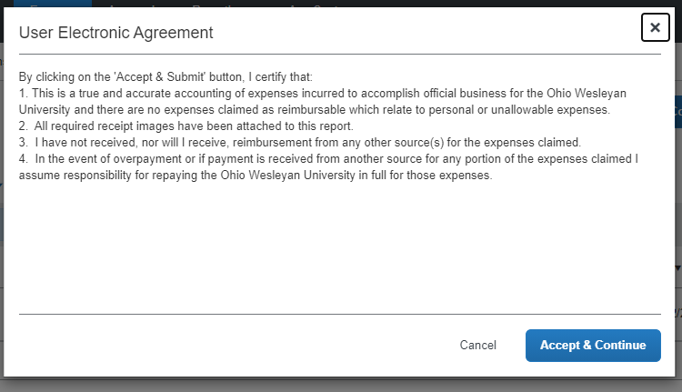
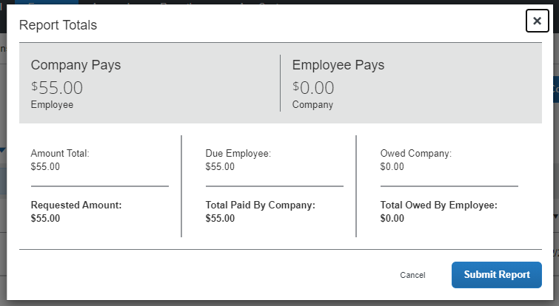
Submitting Reports
Once complete, click Submit Report
A confirmation will appear with a reminder about financial responsibility
Concur will alert you if there are exceptions on your report that need to be fixed
Click Accept & Continue, then Submit Report on the subsequent popup

Slide 36
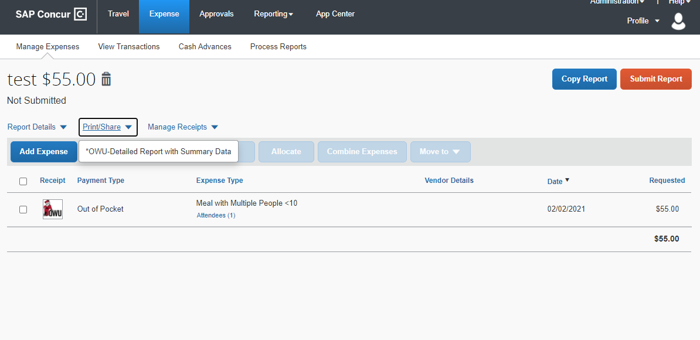
Printing and Saving a Report
You can print or save a summary of the report if you would like. You can have the summary show itemizations and more detail for each expense if you would like as well.

Slide 37
Acting as a Delegate
To create a report on behalf of another user, the user must first set you as a delegate in their profile settings
Delegates can create reports for those users and upload receipts to those users’ accounts
Delegates can be added permanently or temporarily (useful if the user is going on vacation)
The user must log into Concur as themselves to file any missing receipt affidavits
  This is because the missing receipt affidavit acts as an electronic signature
  If a missing receipt affidavit is needed, the delegate can finish all other aspects of the report and then notify the employee that they need to finish it

Slide 38
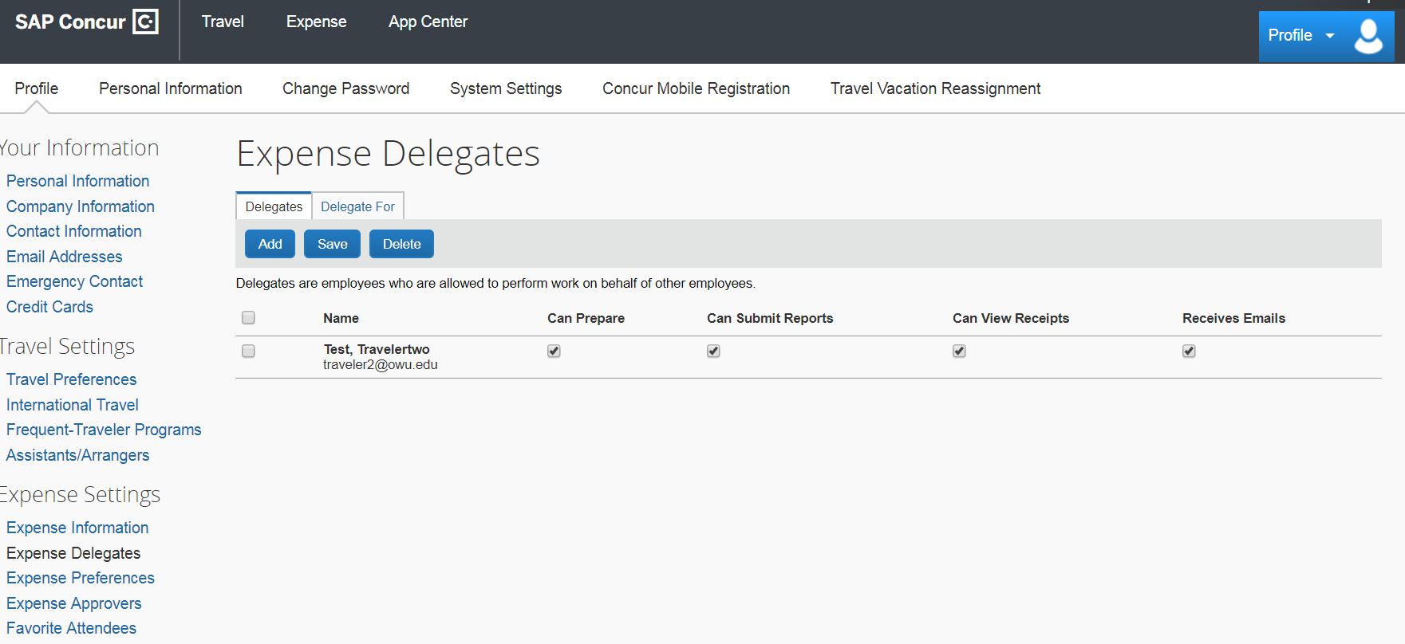
Assigning a Delegate
Adding a delegate is done in the user’s profile settings. The user can add multiple people as delegates and delegates can prepare reports for multiple users.

Slide 39
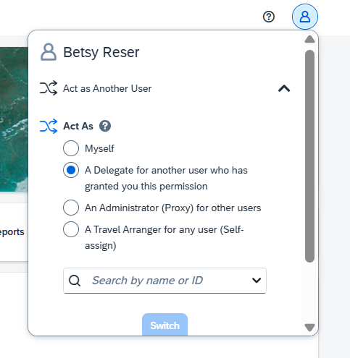

Delegate Access
Delegates log into Concur as themselves, then click on their profile to act as a different user.
Their profile icon will change to show that they are acting on behalf of another person.

Slide 40
Approving Reports
Approvers receive an email when a report is submitted for their approval
  Approvers have 10 calendar days to take action on an expense report
Approvers should:
  Review the report details
  Check the account number
  Confirm that all necessary receipts are included
Approvers can send reports back to the preparer with comments if something needs to be modified before approval

Slide 41
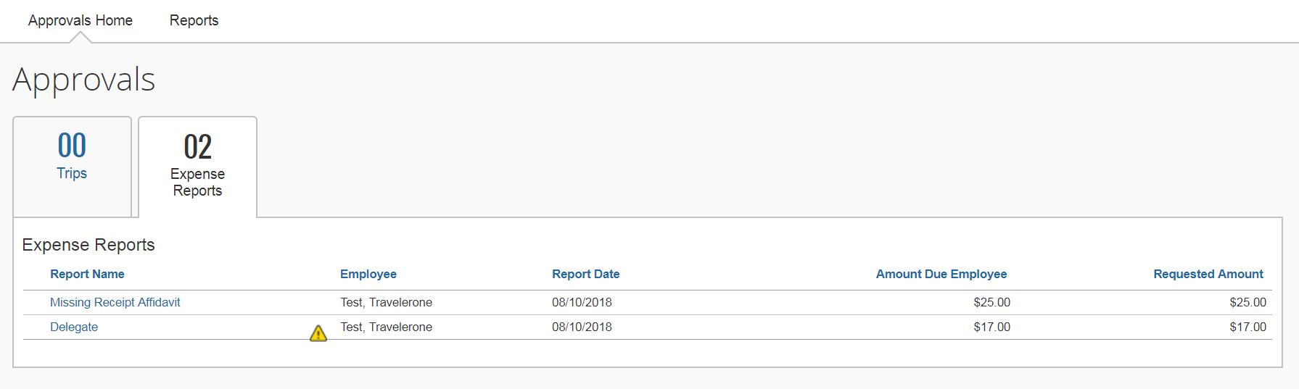
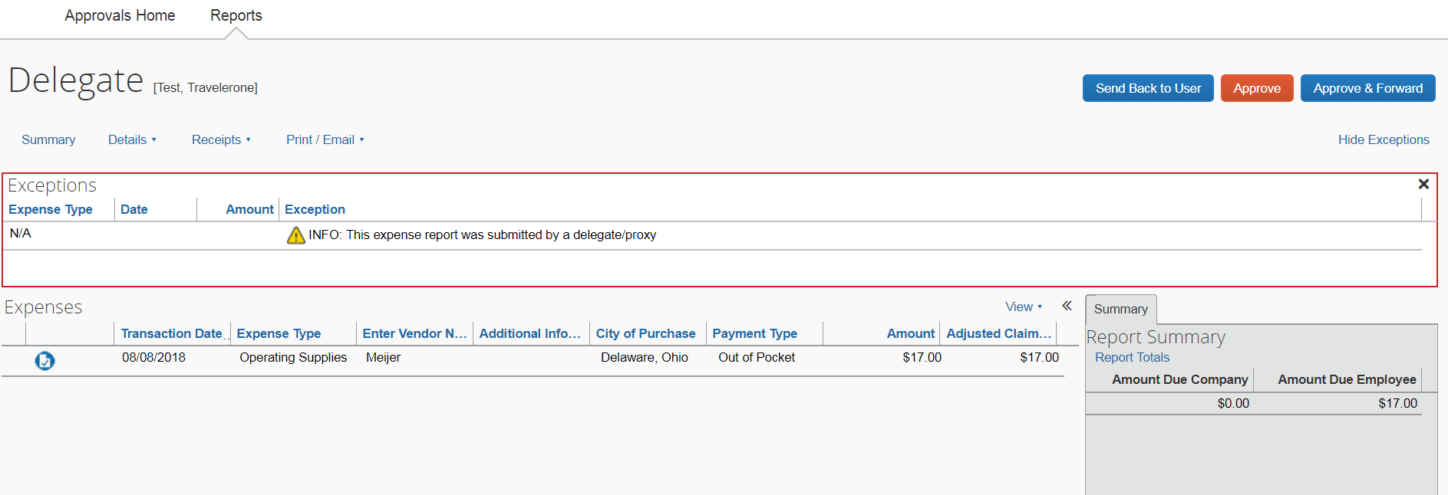
Approver Display
The approver clicks on “Required Approvals” on the home screen.
The approver clicks on which report they want to approve.
The approver clicks “Approve” or “Send Back to User”.

Slide 42
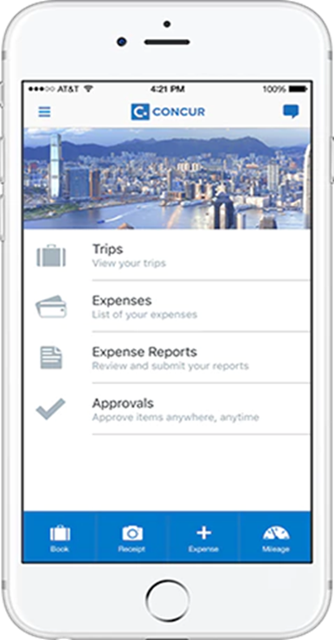
Concur Mobile App
A quick and easy method for uploading receipts and supporting documentation
Has a built-in mileage tool
Entire reports can be submitted and approved through the app
Travel can be booked through the app
Compatible with Apple and Android products
Log in with your OWU credentials

Slide 43
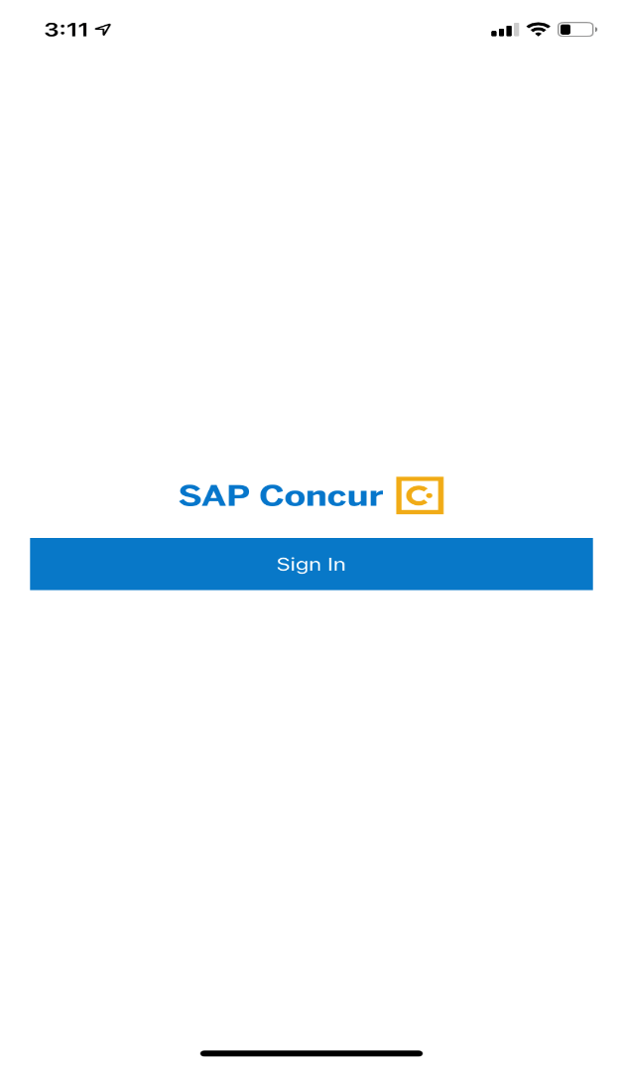
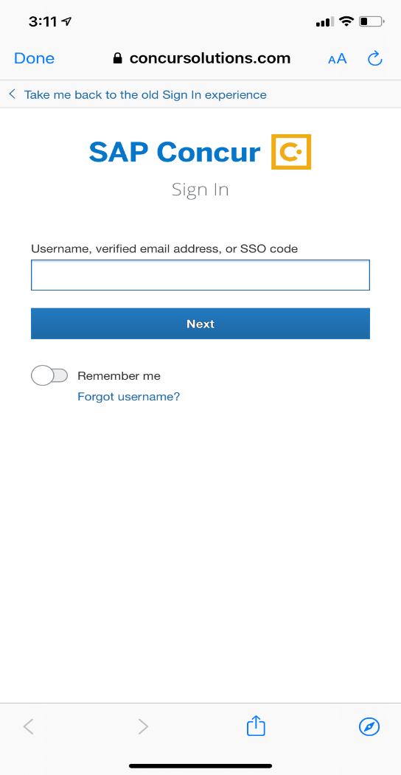
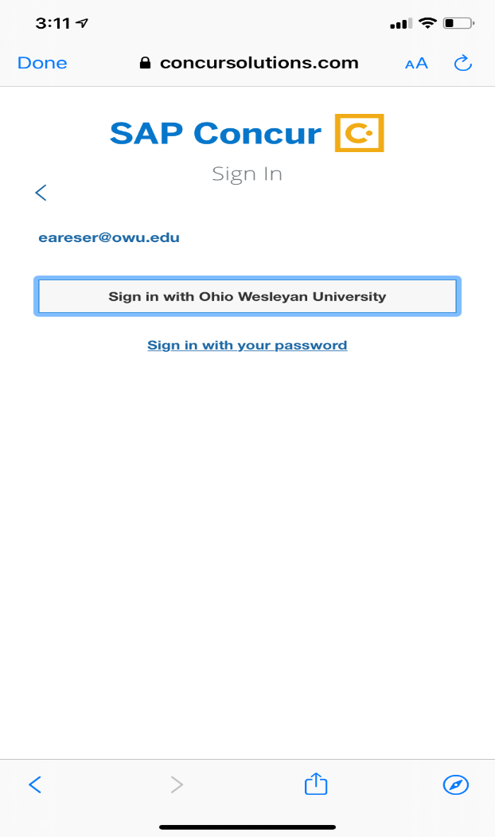
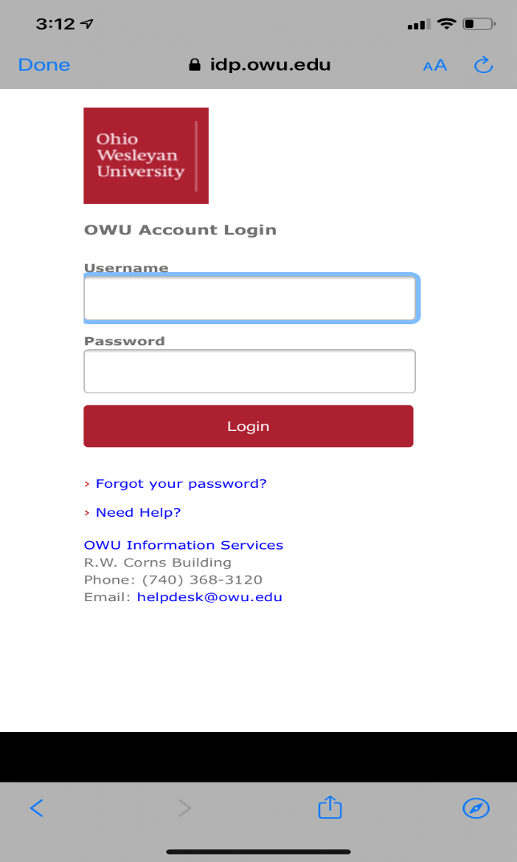
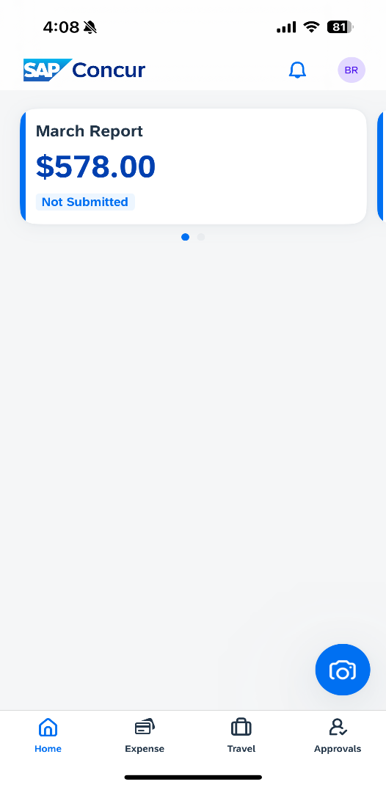
Logging into the Concur Mobile App
1. Download the SAP Concur mobile app from your phone’s app store.
2. Enter your full OWU email address in the username box and click “Next”.
3. Click on “Sign in with Ohio Wesleyan University”.
4. Log in with your myOWU credentials.
5. Use the app to take photos of receipts, complete expense reports, book travel, and approve!

Slide 44
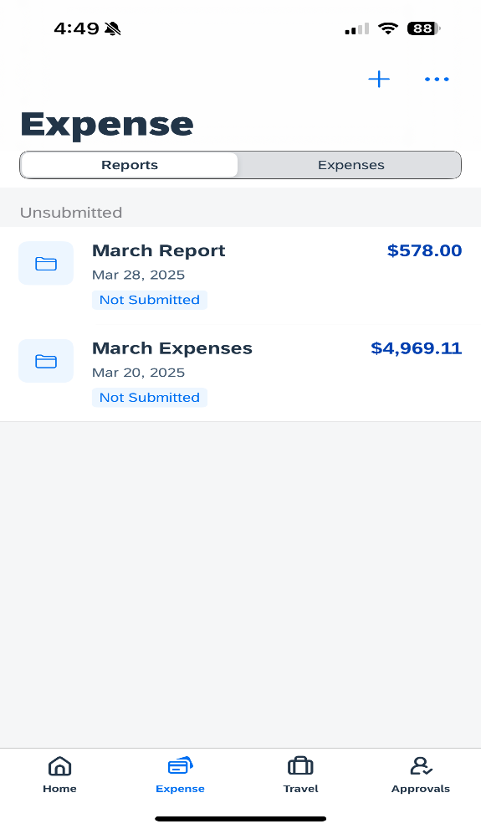
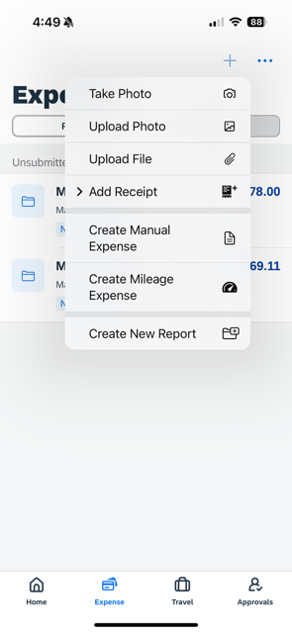
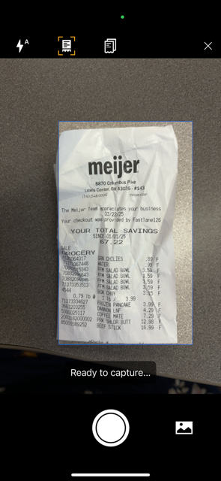
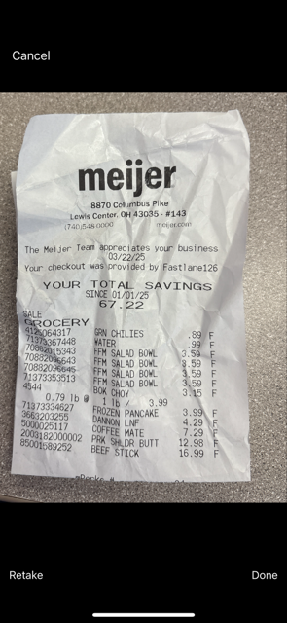
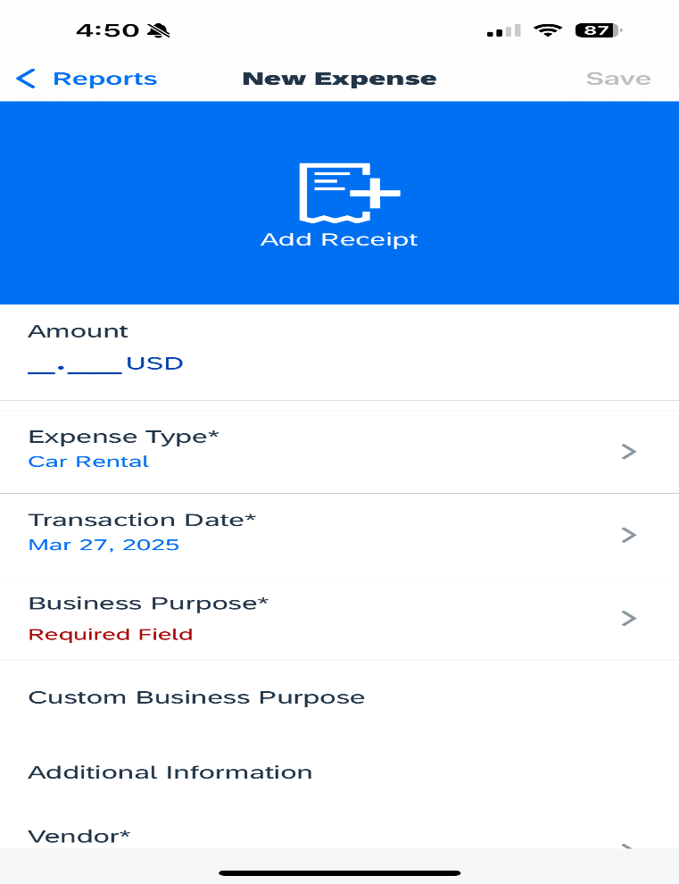
Capturing Receipts with the Concur App
Open the app and click Expense at the bottom of the page
Click on the + icon and choose “Add Receipt”
Take a photo of the receipt or upload from your photo library
Click “Done” to save and finish
(Optional) Add expense type, amount, comments and click “Save.” The app may try to do this for you.

Slide 45
Cash Advances
Cash advances are now requested using Concur rather than via paper.
Please allow 10 days for an advance to be processed. After you request it, it will be approved by your supervisor, then it will go to Accounting.
Advances must be cleared within 30 days.
ATM withdrawals are treated like cash advances by Concur. ATM withdrawals are limited. We strongly urge people who need cash for an upcoming trip to plan ahead and obtain the advance through Accounting.
Advances are assigned to a report and the out-of-pocket transactions are entered with supporting receipts. As the out-of-pocket transactions are entered, the “available” cash advance balance will decrease.
Any remaining money should be brought in U.S. dollars to the Accounting office.
If you have any questions, please contact the Accounting office!

Slide 46
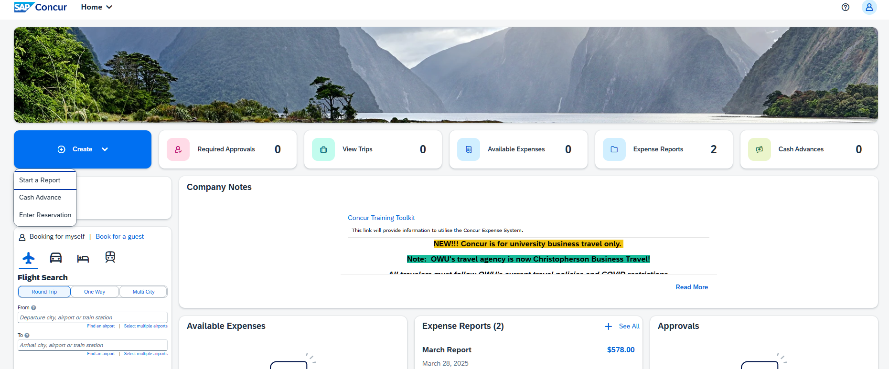
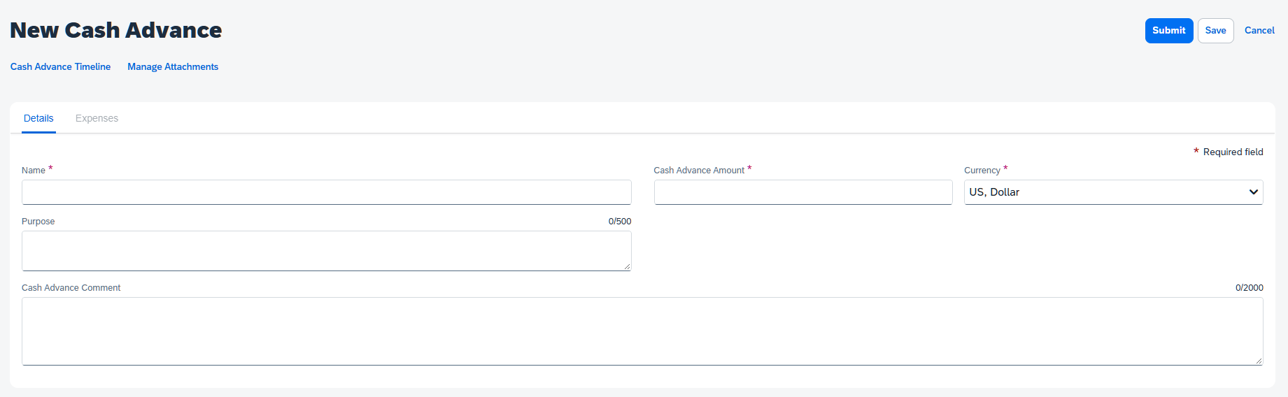
Requesting a Cash Advance
To request a cash advance, either click on the Create button then Cash Advance, or click on Cash Advances then Request Cash Advance. Name the advance and enter the amount, then click Submit.
The advance will go to your default approver, then Accounting.
Allow at least 10 days to receive the advance, as there is one check run per week. Advances will be deposited into whatever bank account you have set up with Payroll.

Slide 47
Clearing a Cash Advance
Within your expense report, click on Report Details, then Manage Cash Advances. You will then see a list of your cash advances that need cleared. Check the box to the left of the advance and click Add.
Once you assign a cash advance to a report, you will see a box at the top of the report with the overall total of the advance and the amount remaining. The amount remaining will decrease as you add out of pocket transactions to the report.
Use the blue Add Expense button to add out of pocket transactions to the report.
For cash advances obtained via Concur, return any extra funds to Accounting. They will mark that portion of your advance “returned.”
For ATM withdrawals, add the remaining portion of the advance to your report by creating an out of pocket transaction with the expense type ATM Cash Return.
  This expense type is only visible if you have an ATM withdrawal assigned to your report.
All remaining funds should be brought back to Accounting in U.S. dollars.

Slide 48
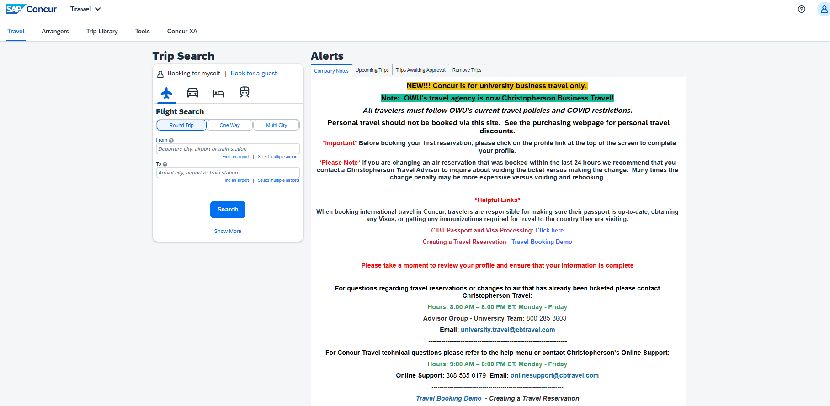
Booking Travel through Concur
According to the travel policy adopted in the fall of 2018, all travel must be booked through Concur or Christopherson Business Travel (our designated travel agent) unless explicitly given prior permission from the Purchasing office. Concur has a simple booking tool and several safety features. The contact information for Christopherson is also listed on the Concur site.

Slide 49
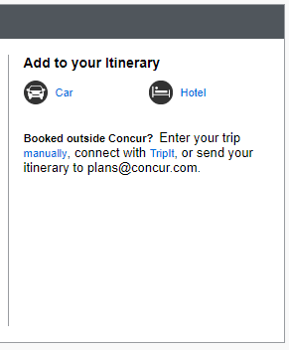
Adding to An Itinerary
If you have already booked a portion of your trip and need to book a car or hotel for the same trip, you can add it to your existing reservation.
Click on Travel, then Trip Library, and click on the link to your trip.
From there, you can add a car or hotel to the same itinerary. You cannot add additional flights to an existing itinerary.

Slide 50
Other Concur Travel Tips
Make sure all of your travel preferences, discounts, rewards programs, and TSA pre-check numbers are loaded into your profile in Concur before you book travel.
We have a corporate discount with The Parking Spot! You can reserve a spot at The Parking Spot when parking at the airport and save considerably when compared to the garage and lots. The Parking Spot will shuttle you to your terminal.
Download the TripIt app! TripIt loads all of your trips from Concur and provides a simplified view of your upcoming travel. It loads all of your confirmation numbers, can alert you to check in, can alert you when it’s time to leave for the airport, and has maps and information on each airport you are traveling to.

Slide 51
Bishopbuy
Bishopbuy is our e-procurement system. It is used for:
  Orders from suppliers that have given us links to their catalogs (including Amazon, Friends Office, HP, CDW-G, Fisher Scientific, VWR, Thomas Scientific, Millipore Sigma, etc.)
  Check requests (used for honorariums, sports officials, outside security services)
  Non-catalog requisitions (goods or services that are over the P-card limit or when the vendor doesn’t accept credit cards)
  Blanket purchase orders (used when paying a vendor multiple times over the course of the fiscal year)
  Motorpool reservations
  Business card and name tag orders
  Wire transfer requests (used when paying an international vendor that doesn’t accept U.S. checks)
  Budget transfer requests

Slide 52
How to Access Bishopbuy
Bishopbuy can be accessed from my.owu.edu
If your OWU credentials do not work, please contact Purchasing or IS to be added to the system

Slide 53
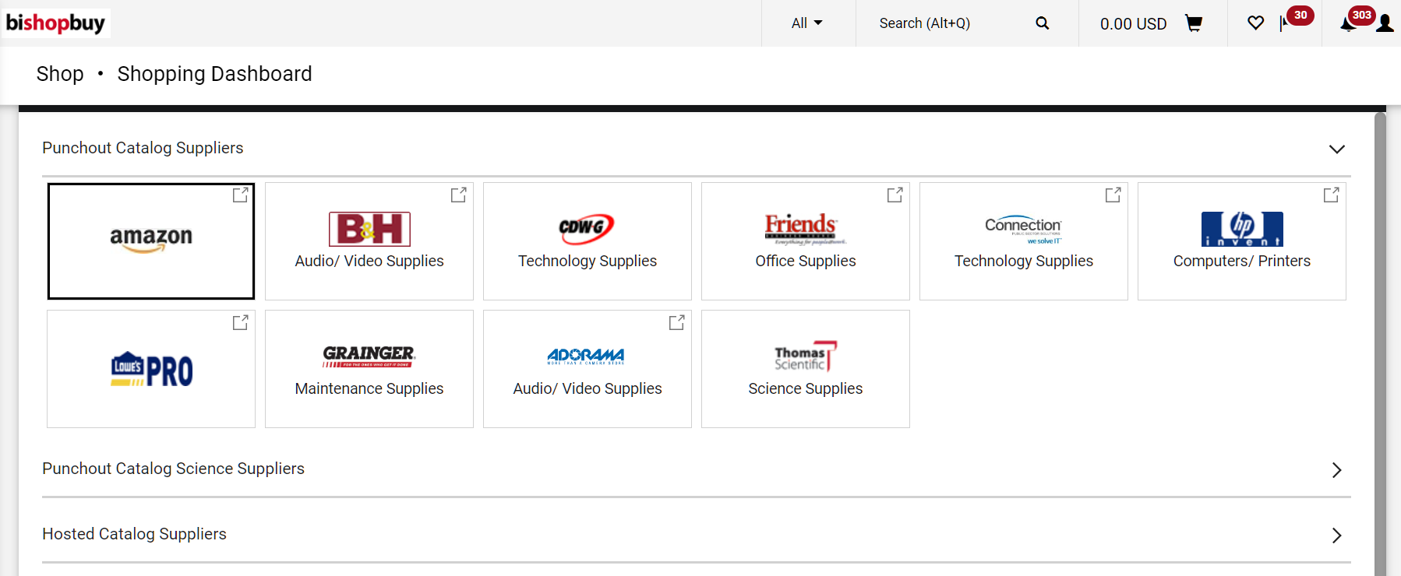
Shopping Home Page
The shopping home page has links to the punchout suppliers, plus all the form types that we use.

Slide 54
Placing a Punchout Order
For the punchouts, like Amazon, click on the link provided on the home page. You may need to enable popups in your browser settings.
Shop for your items like any other online shopping site.
There will be an option in the cart to “transfer your cart” back to the e-procurement site.

Slide 55
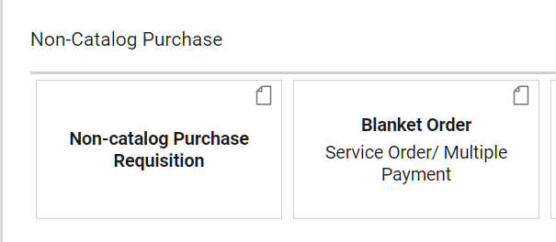
Creating a Non-Catalog or Blanket Requisition
The non-catalog purchase requisition form is used for goods or services that are over the P-card limit or a restricted P-card item (i.e. furniture).
The blanket requisition form is used when paying a vendor multiple times over the course of a period of time. It sets the funds aside in the budget so they can’t be used for something else.
Click on the form type and search for your supplier in the Supplier Search box. If they don’t appear, enter Purchasing Dept.
Complete any field with a star beside it and attach a quote (if you have one).

Slide 56
Check Requests and Wire Transfers
Check requests are used for honorariums, non-employee or student stipends, sports officials, outside security services, or subscriptions or dues where the vendor doesn’t accept a credit card.
  Some sort of documentation MUST be attached
Wire transfer requests are used to pay international vendors that don’t accept U.S. checks or credit cards
  The vendor’s banking information MUST be attached

Slide 57

Processing Your Shopping Cart
After you have added an item from a punchout or a form type to your shopping cart, you can click on the shopping cart in the top right hand corner of the screen.
The cart name defaults to a combination of the date and your user ID, but you can change the name if you would like.
If you don’t know any of the account number details, you can assign the cart to someone else to process. Otherwise, click Proceed to Checkout.

Slide 58

Finalizing Your Requisition
Every requisition will ask for:
  A shipping address
  An account number
  A requested delivery date (this is really a budget check date)
Click on the pencil icon to edit any of the fields
Once all the required fields are completed, click Place Order
The requisition will check the budget to make sure the account number exists and that there are sufficient funds in the account.
Then it will go through the financial approvals and become a purchase order once those are completed.
The purchase order will get sent to the vendor automatically.

Slide 59

Splitting a Requisition Between Account Numbers
If you are splitting a requisition between account numbers, you will complete the form type multiple times – once for each account number. Make sure the price matches the amount you want to charge to that particular account number.
Your cart should have one line for each account number you want to charge.
From the requisition page, click on the three dots beside the line and choose Override Accounting Codes. You can then enter the account number you want to charge. Repeat for each line.

Slide 60

Creating a Quantity Receipt
Once you have an item or a service that you created a purchase order for has been completed, you must create a quantity receipt.
The quantity receipt will match against the invoice that Accounting enters on the PO. When these match, it allows the vendor to be paid.
If there is an invoice on the PO, you will get an email from the system asking you to create a quantity receipt.
From the PO, click on the three dots and choose Create Quantity Receipt.

Slide 61

Creating a Quantity Receipt
If you got all the items on your PO, you can click Complete and you are all done.
If you did not get all of the items, you can click on the trash can beside the line to remove it from your receipt.
If you are creating a receipt on a blanket PO, you can adjust the quantity and enter the amount that you need to receive to match the invoice.

Slide 62

Approving in Bishopbuy
When a requisition is pending your approval, you will get an email from the system.
Log into Bishopbuy and click on the flag notification in the right hand corner next to the shopping cart.
You can click Approve, or you can click on the requisition first and then click Approve or Approve and Next.
If you need to send the requisition back, you can assign it to yourself, then send it back to the requestor.

Slide 63

Assigning a Substitute Approver in Bishopbuy
If you are going to be on vacation or out of the office and unable to approve requisitions pending your approval, you can assign a substitute approver to your approval folders.
From the profile icon in the top right hand corner, click on View My Profile, then Ordering and Approval Settings, then View Assigned Approval Folders.
Check the boxes beside the requisition folders and click on Go.
You can search for the substitute and include a date range for substitution.

Slide 64
Support
Pertinent policies and training materials are available on the Purchasing website:
  https://www.owu.edu/about/offices-services/office-of-finance-administration/purchasing-department/
Contact us if you have any questions!

