Slide 1
Recruiting process
Ohio Wesleyan Staff Positions

Slide 2
Search plan document
1st time users should read through the search Plan document
overview process
Required preparation
Required actions
expectations
Search Plan documents

Slide 3
Search Committee Required DEI Training
All search committee members must complete DEI training before candidate review begins
  All employees; personal skills for a diverse campus
  Search committee; skills for academic searches and hiring
    Both courses can be found in OWU Blackboard: Dei training
      Log in with your OWU credentials

Slide 4
Initiating the search
University President’s approval is required for all searches
An Approval Signature from a member of the president’s cabinet on Page 4 of the search plan confirms that they have received permission from the president to fill the position and initiate the search process.
Search Plan Process Document
Initiate Search – Approvals, pg 4

Slide 5
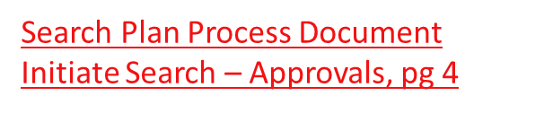
INITIAING the Search Plan
- easy as 1,2,3
A Completed search plan includes;
  Approval by VP or Cabinet - Search Plan Doc, page 4
    VP/Cabinet approval indicates authorization by the University President
  Job Posting – Search Plan Doc, Pages 5-6
  Job description

Slide 6
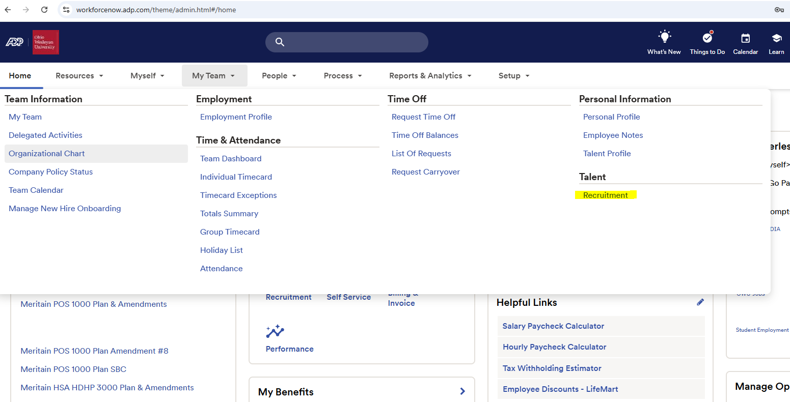

Application Review
Candidates apply through ADP module
Application notification via email
Application review in ADP
ADP/MYTEAM/TALENT/RECRUITMENT

Slide 7
Top candidates, review candidate pool
Search Plan Doc, pg 7
Review for diversity
Top candidates
Recommended candidate
Diversity within the candidate pool is important
Contact HR to run a diversity report
This will help determine if additional targeted advertising is necessary
Submit you list of top candidates to HR
final diversity report of top candidates – HR to run repot
This ensures a diverse top candidate pool
Review final candidate with your VP
Indicate the top candidate, compensation offer, and target start date
Search Plan Doc, Pg 7

Slide 8
Hiring the candidate
Data Requirements for new hires - Search Plan Docs, pg 8
Approvals needed PRIOR to extending offer
  Approval by VP or Cabinet member
    VP/Cabinet approval indicates authorization by the University President
  Department Manager Approval
  Human resources Director Approval
Search plan documents, pg 8

Slide 9
Hiring process – next steps
Once verbal offer is accepted, HR will prepare and send formal offer of employment letter
Conditions of employment –
  must pass criminal background screening
    Allow 2 weeks lead time or more
  Reference checks – completed by hiring manager

Slide 10
Questions?

