Slide 1
Concur Travel & Expense

Slide 2
Agenda
Overview of Concur
Setting up your profile
Creating expense reports
P-Card and out-of-pocket expenses
How to capture receipts
The delegate process
Approving reports
Getting help

Slide 3
Benefits of Concur
Integrated travel and expense system
Single sign-on
Log into Concur using your OWU user ID and password
Mobile capabilities
Book travel and submit/approve expense reports via your mobile device (iPhone/iPad and Android)
Electronic capture of receipt images
Users can take photos of receipts using their phone and email them easily to Concur
Receipts from some vendors will automatically feed into Concur (i.e. Uber)
Link personal travel rewards programs and save preferences for travel
Incorporates OWU’s policies and guidelines

Slide 4
How to Access Concur
Concur can be accessed from:
my.owu.edu
https://www.owu.edu/about/offices-services/office-of-finance-administration/purchasing-department/concur-travel-expense/
Training materials and helpful contacts will be located here
Log in using your OWU user ID and password

Slide 5
Concur Dashboard
The Concur dashboard shows a quick view of your open expense reports, unassigned P-Card charges, and reports awaiting your approval.

Slide 6
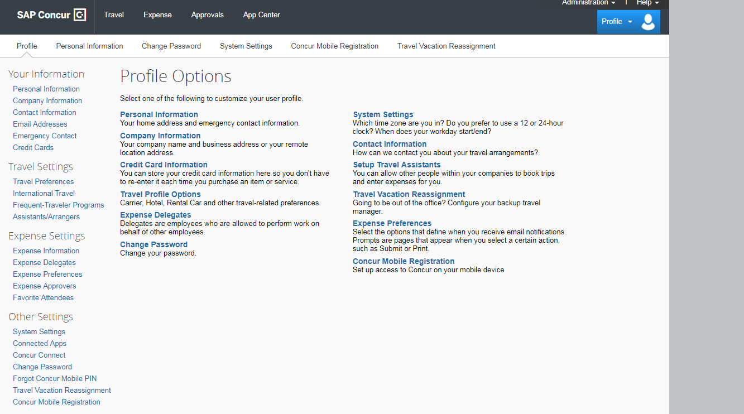
Updating Your Profile Settings
When logging into Concur for the first time users should go to the Profile Settings screen to update their personal information. Make sure you:
Verify that your name matches your legal ID
Verify your email address to receive e-receipts
Set up a mobile PIN to use the Concur app
Adjust your travel preferences
Add expense delegates and/or travel assistants if needed

Slide 7
Creating an Expense Report
Concur allows users to create their own expense reports with ease
P-Card charges are automatically loaded from Chase into a user’s account
Out-of-pocket charges (personal cards or cash) can be entered manually on the website or through the Concur mobile app
Receipts can be entered by using the Concur app, by emailing them to your account, or by uploading them from your desktop
Some receipts may also push through Concur automatically from the vendor

Slide 8
Expense Report Dashboard
The Expense screen allows you to create a new report, access open or returned reports, and view or recall submitted reports. You can view older reports using the Report Library.

Slide 9
Expense Report Header
The report name, business purpose, and default account number are entered on the Header screen. The required fields have a red bar to the left of the text box.
We suggest submitting an expense report for each month’s expenses as expenses need to be cleared within 30 days. The details in the Report Header will be copied to each transaction in the report, but the individual transactions can be changed (i.e. if they need to be charged to a different account).

Slide 10
Adding P-Card Charges to a Report
Available P-Card charges open automatically when starting a new report. They can also be viewed by clicking Import Expenses.
To add P-Card charges to an expense report, simply drag and drop them into the report, then add the receipt and edit any missing details. Expense types are autopopulated from the vendor and can be modified.

Slide 11
Adding Out-of-Pocket Expenses
To add an expense that was paid in cash or on a personal credit card, select “New Expense” and choose the expense type.

Slide 12
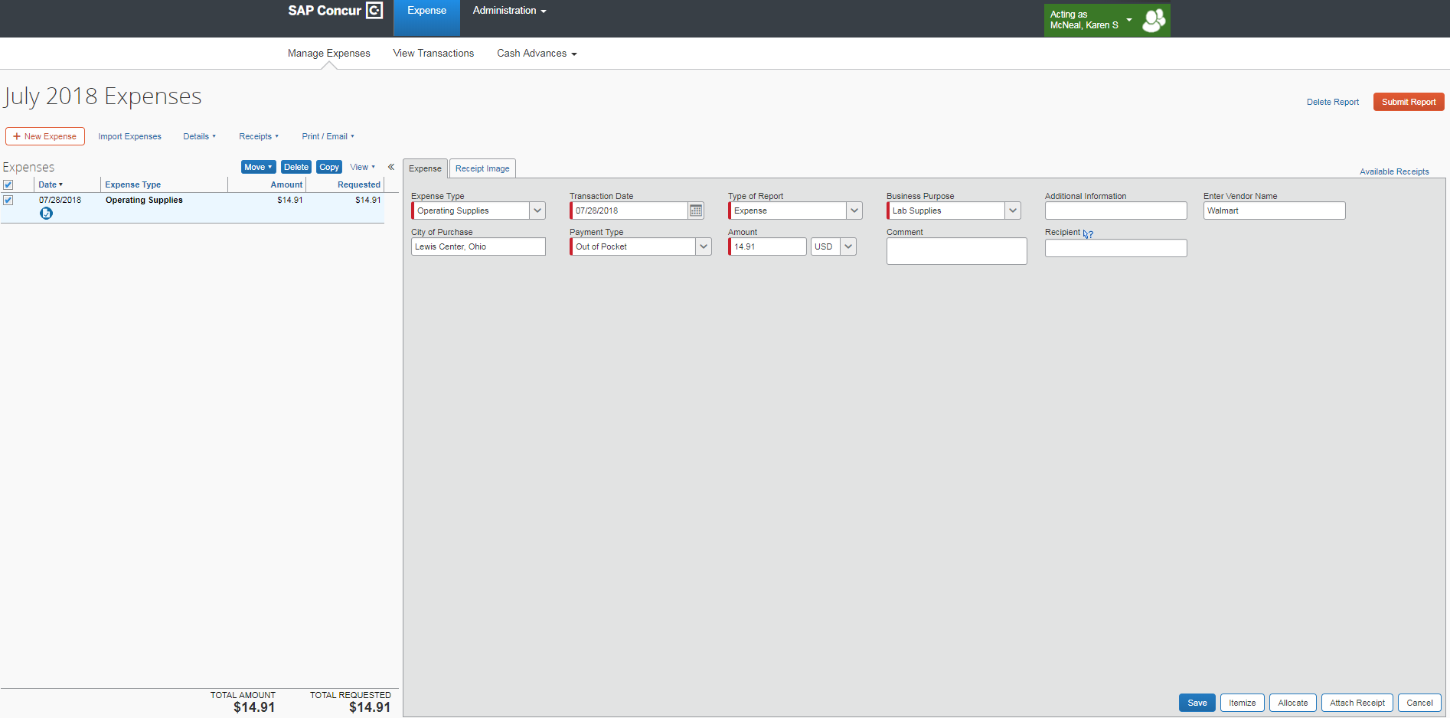
Entering Expense Details
Different expense types require different details. Many fields will autopopulate based on the other expenses you’ve already entered. The Business Purpose can be changed for each line if different than what is in the report header.
After adding or editing any required information, you can save the expense and attach a receipt from your Available Receipts (those that you may have sent via email, the Concur app, or automated from the vendor) or you can attach one from your desktop.

Slide 13
Symbols and Alerts
Concur uses a variety of icons and symbols to provide alerts and reminders about missing receipts, required information, and other details. You can hover your mouse over an icon to open a pop-up with an explanation.

Slide 14
Other Report Information
You no longer need to assign object codes
Concur assigns the object codes based on the expense type of your transaction
Transactions will default to the account number entered in the report header, but they can easily be allocated to another account or split between multiple accounts based on percentage or dollar amount
Concur will remember your recently used accounts
Certain expense types require itemization (hotels, meals with alcohol)
Concur has a built-in exchange calculator when entering out-of-pocket charges in a foreign currency

Slide 15
Supporting Details
Some expense types require additional details. For instance, group meals require attaching a list of guests to the expense report.

Slide 16
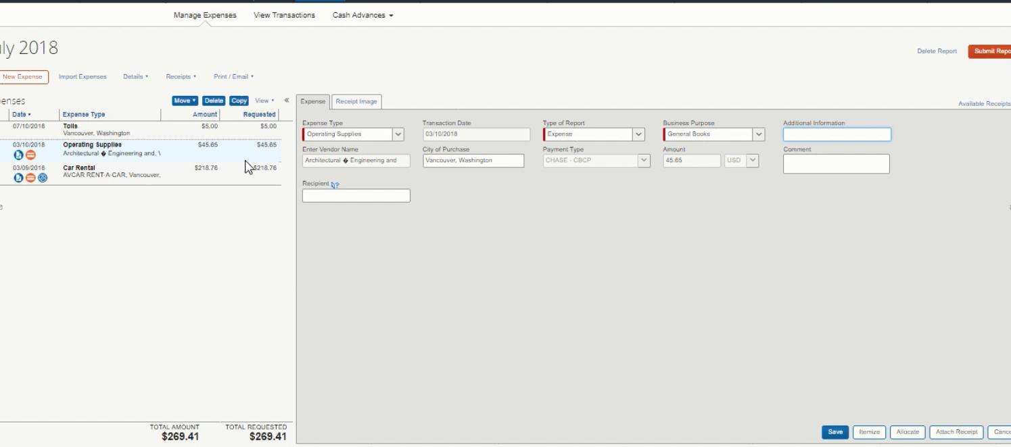
Itemizing Expenses
Sometimes you may need to itemize your expenses. This is common for expenses such as meals with alcohol and hotel stays. Also, if you had a personal purchase on the same transaction as a business expense, you can itemize the expense.

Slide 17
Allocating Expenses
You can allocate specific expenses to different account numbers or split them by percentage or dollar amount. You can also save your frequent allocations for quick access.

Slide 18
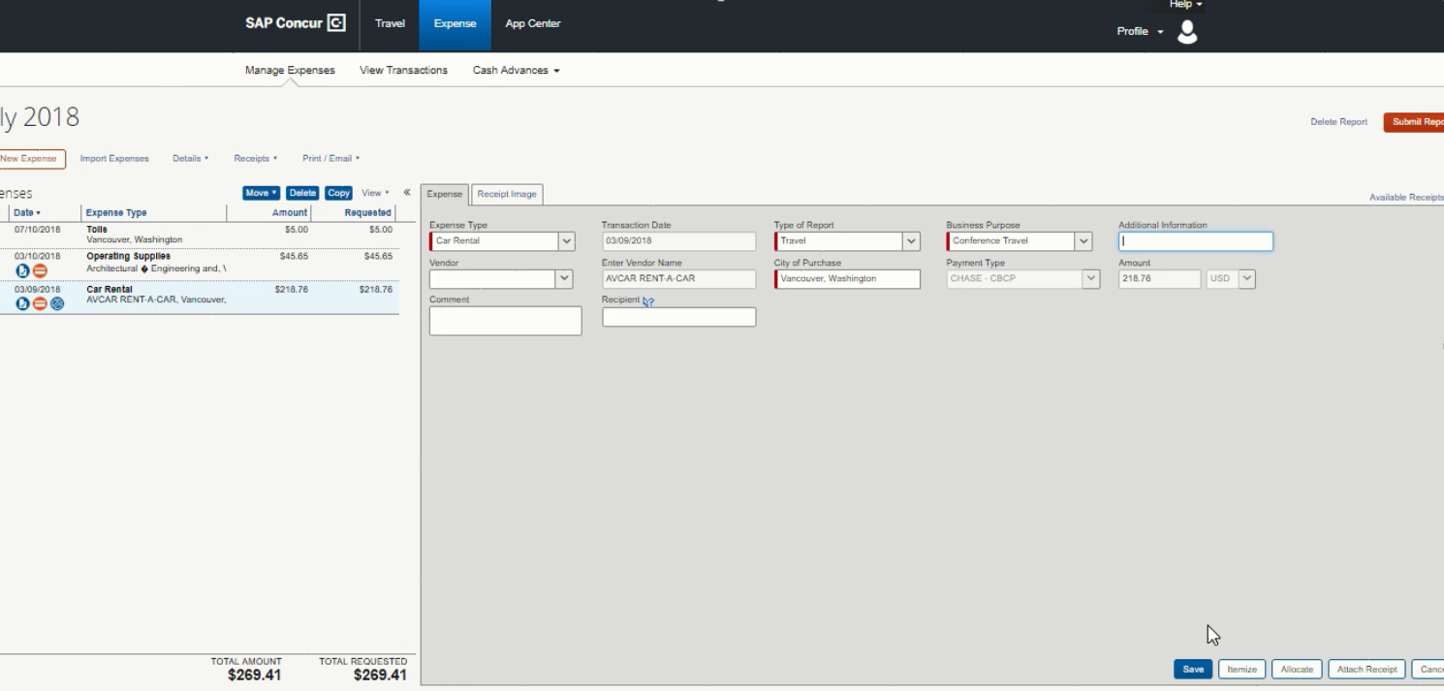
Viewing Allocated Expenses
After allocating an expense, you can view the account number details by hovering over the blue allocation icon. This icon appears whenever a line is charged to an account different than the default account for the report.
After allocating an expense, you can view the account number details by hovering over the blue allocation icon. This icon appears whenever a line is charged to an account different than the default account for the report.

Slide 19
Expenses using Foreign Currency
Charges made in foreign currency on your P-Card will automatically convert to U.S. dollars. When adding an out-of-pocket expense in a foreign country, Concur will automatically add the exchange rate based on the date and location. This rate can be overridden when needed.

Slide 20
Calculating Mileage
Concur has a built-in mileage calculator for you to enter to and from locations in lieu of attaching Mapquest printouts. It automatically calculates the reimbursement based on the mileage.

Slide 21
Importing Receipts
Use the Concur mobile app to take photos of your receipts
Photos taken in the app are uploaded to the account associated with that phone
Send the receipt by email to receipts@concur.com
The email must come from a verified address (done in Profile Settings)
.png, .jpg, .jpeg, .pdf, .html, .tif, .tiff files are all accepted
Upload receipt images from your desktop to your account
If your receipt has been misplaced and all other methods of obtaining a receipt have been exhausted, a missing receipt affidavit can be electronically filed

Slide 22
Available Receipts
Your available receipts (e-receipts, those you’ve emailed to receipts@concur.com, and those you’ve uploaded will appear here

Slide 23
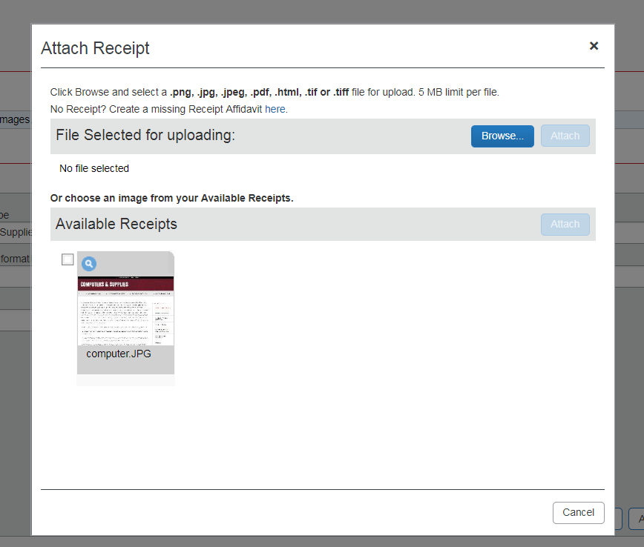
Adding a Missing Receipt Affidavit
Before uploading a missing receipt affidavit all avenues of obtaining a receipt should be exhausted
Some expense types will not accept a missing receipt affidavit
No one can submit a missing receipt affidavit on your behalf

Slide 24
Adding a Missing Receipt Affidavit

Slide 25
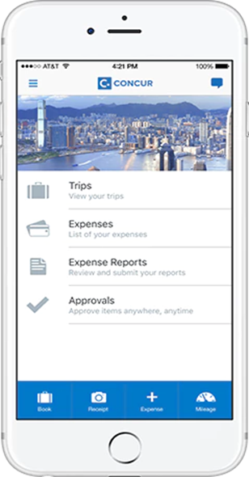
Concur Mobile App
A quick and easy method for uploading receipts and supporting documentation
Has a built-in mileage tool
Entire reports can be submitted and approved through the app
Travel can be booked through the app
Compatible with Apple and Android products

Slide 26
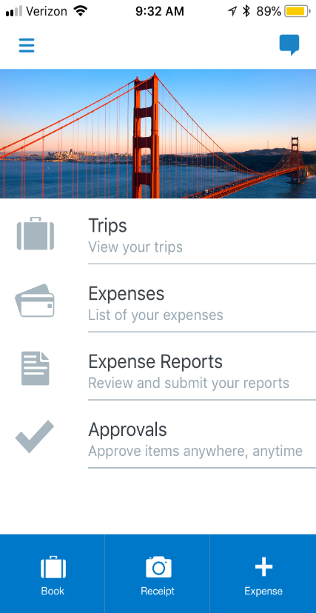
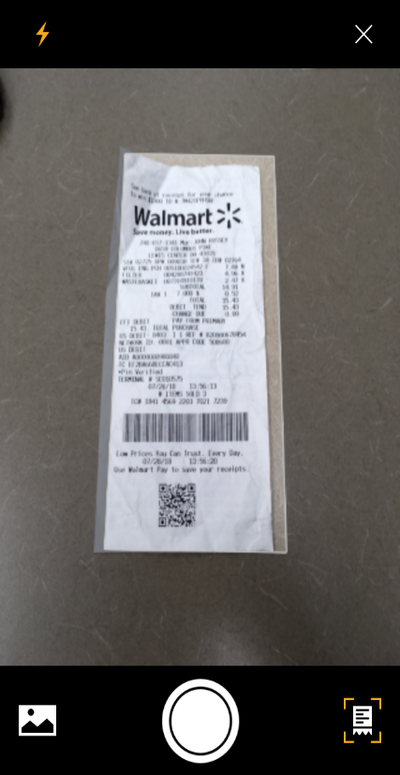
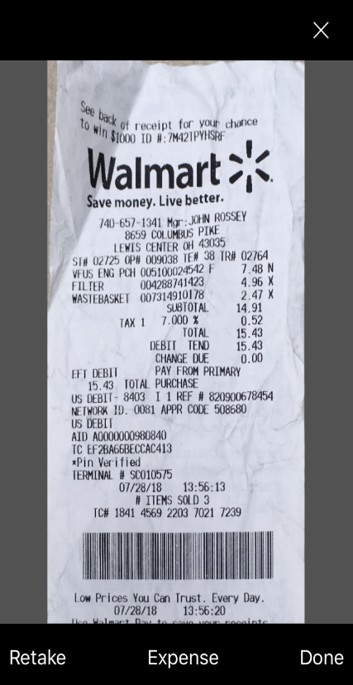
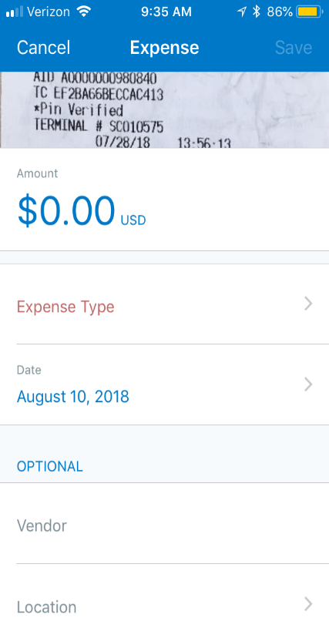
Capturing Receipts with the Concur App
Open the app and click “Receipt”
Take a photo of the receipt
Click “Done” to save and finish or click “Expense to add optional details
(Optional) Add expense type, amount, comments and click “Save”

Slide 27
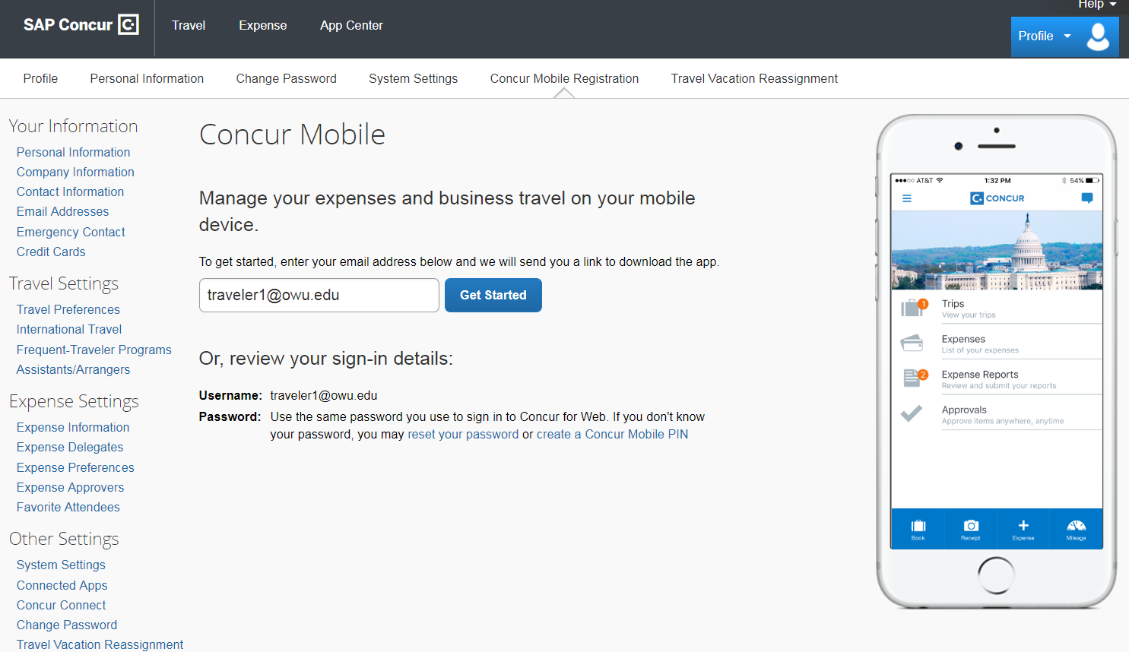
Setting Up Mobile Access
Before using the Concur app, you need to create a mobile PIN. This is done in Concur Profile Settings under Mobile Registration. Once you are registered, you can login to the app using your OWU user ID and mobile PIN.

Slide 28
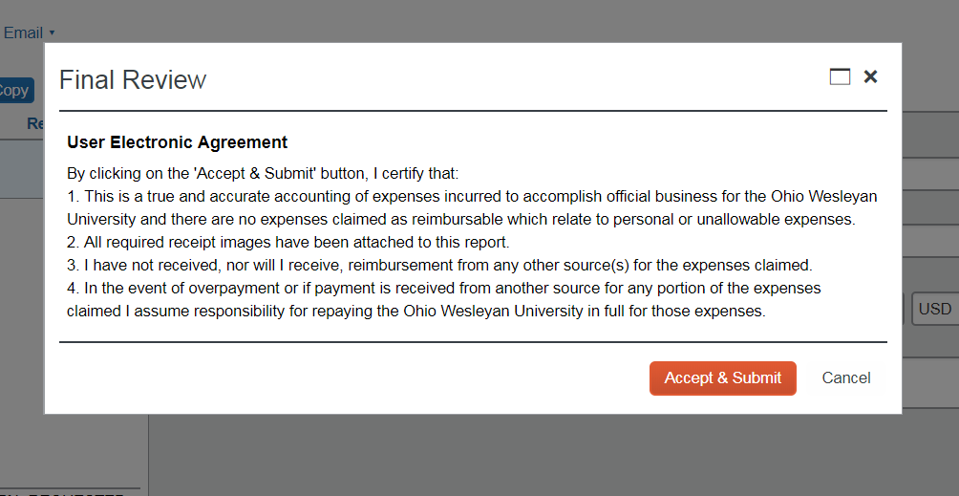
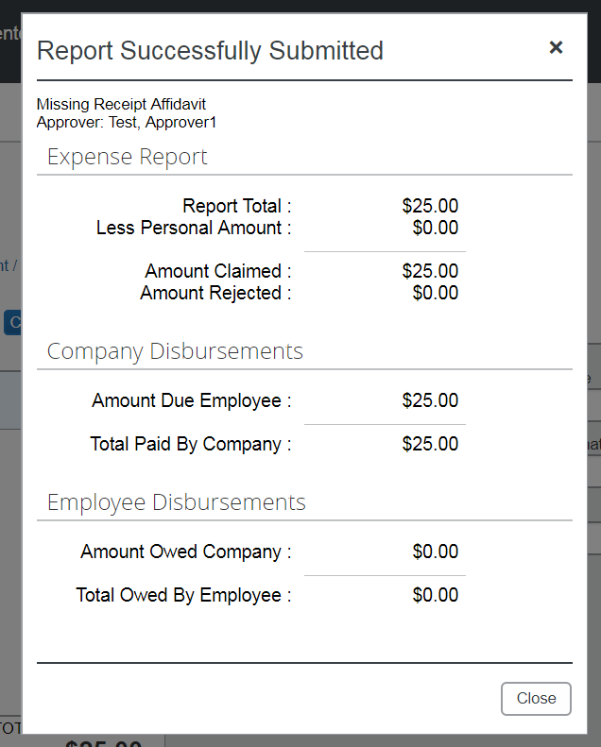
Submitting Reports
Once complete, click Submit Report
A confirmation will appear with a reminder about financial responsibility
Concur will alert you if there are exceptions on your report that need to be fixed
Click Accept & Submit to send your report
After being submitted, a popup will appear with a brief summary of your report

Slide 29
Printing and Saving a Report
You can print or save a summary of the report if you would like. You can have the summary show itemizations and more detail for each expense if you would like as well.

Slide 30
Acting as a Delegate
To create a report on behalf of another user, the user must first set you as a delegate in their profile settings
Delegates can create reports for those users and upload receipts to those users’ accounts
Delegates can be added permanently or temporarily (useful if the user is going on vacation)
The user must log into Concur as themselves to file any missing receipt affidavits
This is because the missing receipt affidavit acts as an electronic signature
If a missing receipt affidavit is needed, the delegate can finish all other aspects of the report and then notify the employee that they need to finish it

Slide 31
Assigning a Delegate
Adding a delegate is done in the user’s profile settings. The user can add multiple people as delegates and delegates can prepare reports for multiple users.

Slide 32
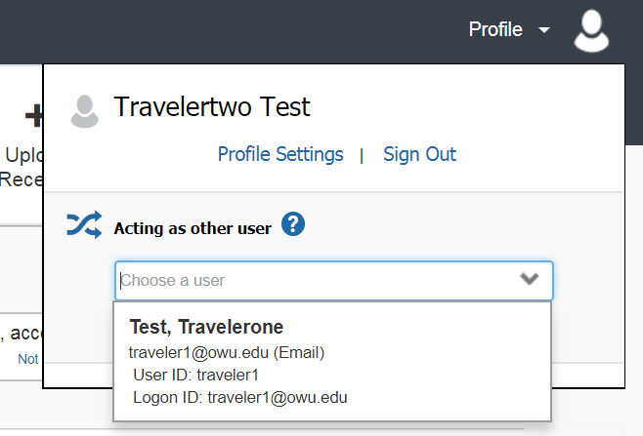
Delegate Access
Delegates log into Concur as themselves, then click on their profile to act as a different user.
Their profile icon will change to show that they are acting on behalf of another person.

Slide 33
Approving Reports
Approvers receive an email when a report is submitted for their approval
Approvers have 10 calendar days to take action on an expense report
Approvers should:
Review the report details
Check the account number
Confirm that all necessary receipts are included
Approvers can send reports back to the preparer with comments if something needs to be modified before approval

Slide 34
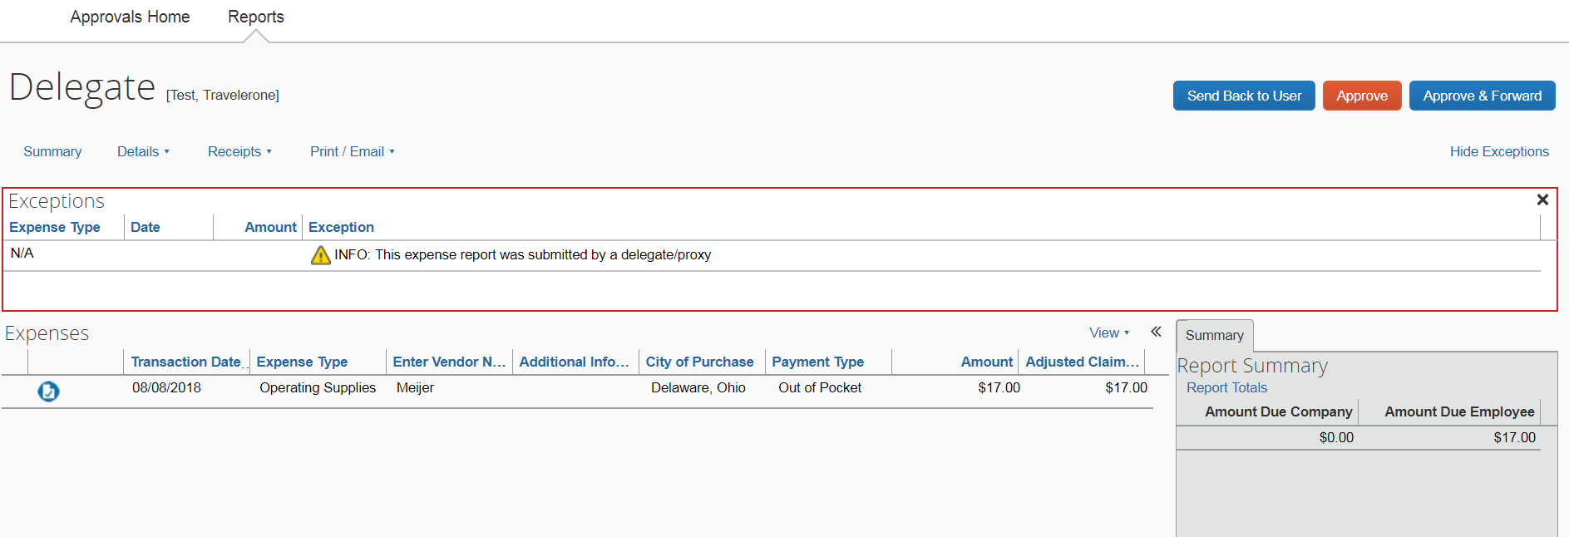
Approver Display
The approver clicks on “Required Approvals” on the home screen.
The approver clicks on which report they want to approve.
The approver clicks “Approve” or “Send Back to User”.

Slide 35
Support
Pertinent policies and training materials are available on the Purchasing website:
https://www.owu.edu/about/offices-services/office-of-finance-administration/purchasing-department/
Contact us if you have any questions!

